Slide 1
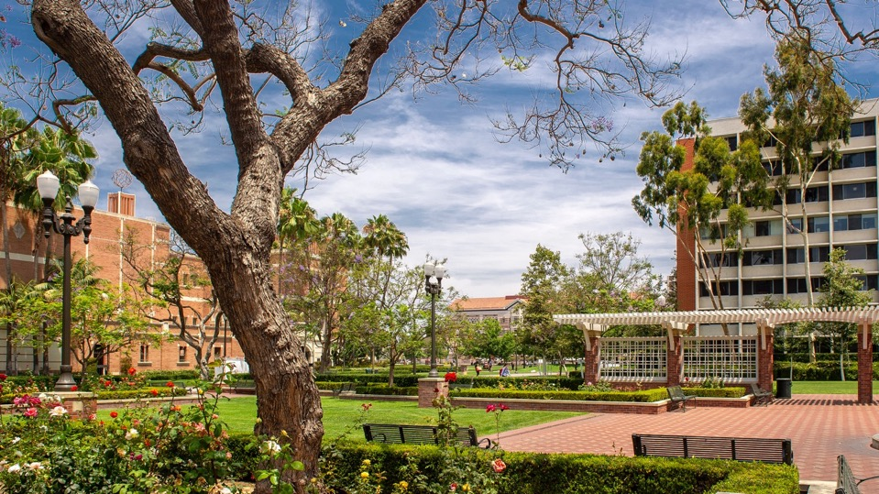

Foundation Relations
Jennifer Lidar
University Advancement

Slide 2
What do philanthropic foundations look for?
Innovative, exploratory, or high-risk, high reward projects
Social and environmental impact
Collaboration and partnerships
Alignment with the foundation’s mission and grantmaking focus

Slide 3
How are foundations adapting to federal changes?
Increasing funding to offset federal cuts
Defending civil society and nonprofit autonomy
Reevaluating Diversity, Equity, and Inclusion (DEI) initiatives
Supporting global health and human rights amid aid reductions
Embracing long-term, strategic investments

Slide 4
What types of funding opportunities do foundations offer?
Request for Proposals (RFP): Communicated to faculty and leadership via School-based bulletins and targeted emails by Foundation Relations
Limited submission: USC may submit a limited number of proposals
          Opportunities posted on the Office of Research website and elsewhere
          PI(s) selected through an internal pre-proposal review process
      Foundation Relations supports selected PI(s)
Invitation to submit: Foundation Relations cultivates a relationship with the foundation that can lead to a proposal invitation. Cultivation may involve the PI(s) when appropriate.

Slide 5
What do USC Foundation Relations officers do?
Identify foundations with grantmaking programs that align with USC funding needs.
Build relationships with foundation board members and program officers.
Disseminate funding opportunity information.
Work with campus leadership and faculty on strategies tailored to the funder.
Help you develop compelling proposal submissions.
  Deep-dive proposal framing/writing/editing
  Answer questions about the foundation, submission process, etc.
  Auxiliary information
  Portal submission

Slide 6
FAQs
How can I help Foundation Relations help me? Keep your USC webpage(s) up to date and include a link to your CV.
When should I contact Foundation Relations? When you have a question, anticipate submitting a proposal, need help with a proposal, or receive a grant.
Can I contact a foundation directly about supporting my work? Contact Foundation Relations before initiating contact with a foundation.
What should I do if a foundation contacts me? Alert us right away. We will help you navigate USC's internal process and assist with the development of your submission.

Slide 7
How to connect with Foundation Relations
Central Advancement team:
Jennifer Lidar, Executive Director of Foundation Relations
jlidar@usc.edu
Dana Irwin, Director of Foundation Relations
danairwi@usc.edu
Hossein Pourmand, Assistant Vice President for Research Initiatives
hpourman@usc.edu

