Slide 1
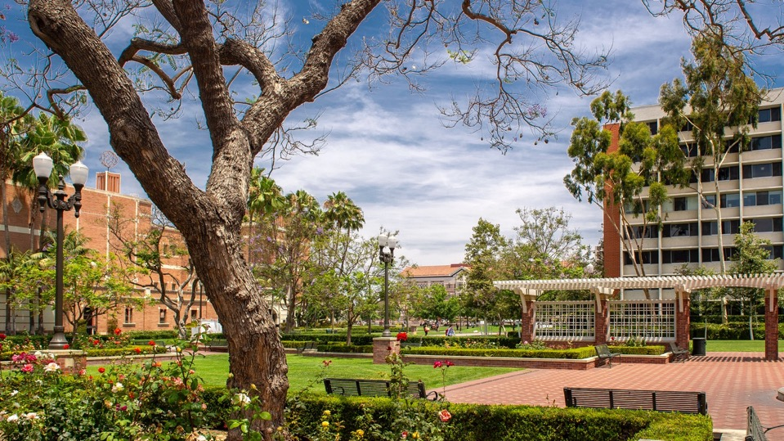
Corporate Funding for Research
Llewellyn Cox PhD
Executive Director, Corporate Relations
2/14/24

Slide 2
AGENDA
USC Corporate & Foundation Relations : Who are we?
Corporate Relations @ USC
How to Win Corporate Funding

Slide 3
CORPORATE RELATIONS: STRUCTURE
Corporate Relations is part of USC Advancement
Central
Schools / Units
Historically gift/philanthropy focused
Currently expanding “Central”
Subject matter experts / school assignments
Smaller portfolios
Corporate Relations vs. Foundations

Slide 4
CORPORATE RELATIONS: STRUCTURE (Cont’d)
Leverage USC relationships (Advancement and faculty)
Close coordination with Office of Research
USC Stevens Center for Innovation
Department of Contracts and Grants
Close collaboration with USC MESH Academy, USC Michelson Center for Convergent Bioscience, USC Institute for Creative Technologies, etc.

Slide 5
CORPORATE RELATIONS: GOALS AND OBJECTIVES
Funding / support for research, academic, and community engagement priorities and programs
Gifts (cash and in-kind)
Grants
Sponsored research
Develop and execute viable and comprehensive strategies (university and/or school)
Understand emerging trends in industry
USC’s strengths across schools and units
Input from faculty and academic leadership
Long-term & mutually-beneficial partnerships
Cultivate relationships with key decision-makers/executives
Leverage USC network
Leverage faculty contact(s)

Slide 6
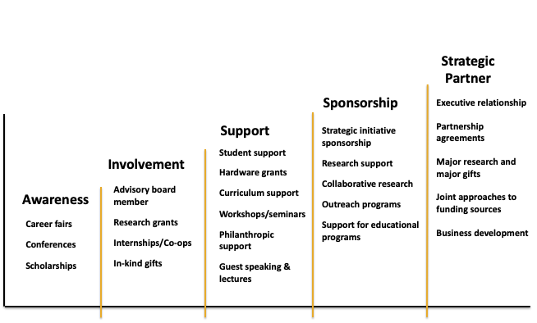
LEVELS OF ENGAGEMENT

Slide 7
CORPORATE RELATIONS: CENTRAL & SCHOOLS/UNITS
Central Corporate Relations
Responsibility for companies with interest across multiple schools /units
Convene strategizing sessions (CR and faculty)
President and Provost priorities
Lead coordination and execution of strategies
Manage multiple / concurrent contacts with corporations
School / Unit Corporate Relations
Primary resource for faculty and researchers
Responsibility for school-specific prospects
Coordinate strategies and activities with faculty, Central, DCG, USC Stevens, MESH

Slide 8
EXAMPLES OF KEY USC CORPORATE RELATIONSHIPS
Agilent USC Dornsife Agilent Center of Excellence in Biomolecular Characterization
Amgen Cryo E/M instruments at Michelson Center for Convergent Bioscience
Amazon USC Viterbi Center for Secure and Trusted Machine Learning
USC Marshall Initiative for Digital Competition
Microsoft USC Viterbi centers, research and student organizations
USC Price Center for Social Innovation
USC Games program
USC Marshall Center for Effective Organization
Google USC Annenberg’s Election Cybersecurity Initiative
Arts and Culture virtual programs
Health policy research
Qualcomm USC Gould’s Center for Transnational Law and Business
Women in Science and Engineering (WiSE)

Slide 9
TRENDS
Corporate philanthropy is shifting towards social justice issues and initiatives
Mostly grassroots organizations
Lower dollar amounts to Higher Education
Corporate research budgets as % of expenses growing
Companies looking for focused and value-added exchanges: Universities are uniquely positioned to convene multi-sectoral and multi-disciplinary groups
“Strategic Partner” universities
Single point of contact to help navigate a large university
Looking beyond science and engineering
Companies of all sizes are engaging with universities
Interest in select corporate advisory boards or affiliate programs

Slide 10
ENGAGING CORPORATE PARTNERS
Networking !
Effective corporate partnerships are built on relationships
Corporate representatives attend most mid / major conferences
Sales/BizDev vs. Corporate strategy
Learn where they have needs – what don’t they know?
Do they sponsor research?
Do they work with other Universities?
How do they approach academic relationships?
Check websites for funding opportunities / information
Engage USC CFR professionals to help manage the engagement
Either in your school / unit OR Central Advancement
(we talk to each other!)

Slide 11
UNDERSTANDING CORPORATE PRIORITIES
Corporate philanthropy takes many forms!
“Traditional” corporate philanthropy (PR)
Grants!
Strategic support
Research interests
Policy interests
Talent development
Student / Postdoc fellowships
Internships
Job fairs
Technology commercialization
Competitions, Hackathons,
Accelerator programs

Slide 12
SUMMARY
Corporations are focusing their engagements on a limited number of universities
Increasingly competitive landscape
Increased need to coordinate our activities and outreach
Corporations represents an important source of funds for USC programs, initiatives and research
USC Corporate Relations officers working with colleagues across the university are well positioned to help faculty and researchers and develop mutually beneficial corporate engagements
USC Corporate Relations are here to help! LLEWELLC@USC.EDU

