Slide 1
USC Research Communications
Promoting faculty and their research
Emily Gersema
Executive Director, USC Media Relations
gersema@usc.edu
Paul McQuiston
Assistant Director, USC Media Relations
paulmcq@usc.edu
Notes:
Thank you for having us. Working with professors is the best part of our job. We were excited when Maja reached out with this invitation and opportunity. I have already learned so much.
I am Eddie North Hager with USC Communication. Per Marion instructions, I work with USC professors to share the impact of their research with the most respected national media outlets.
I am starting my 15th year here and I’ve never been prouder of my affiliation with USC and the response of our administration, faculty students and staff not only to the pandemic, but the dual crisis of social justice. as we not only join in the fight for more civil rights but also by taking a hard look at ourselves. It’s more than talk. I have had the great fortune to work with some of you on this zoom call. But not enough. I hope everybody considers reaching out to us after this meeting.
Last year I brought on Emily Gersema to be my assistant director.

Slide 2
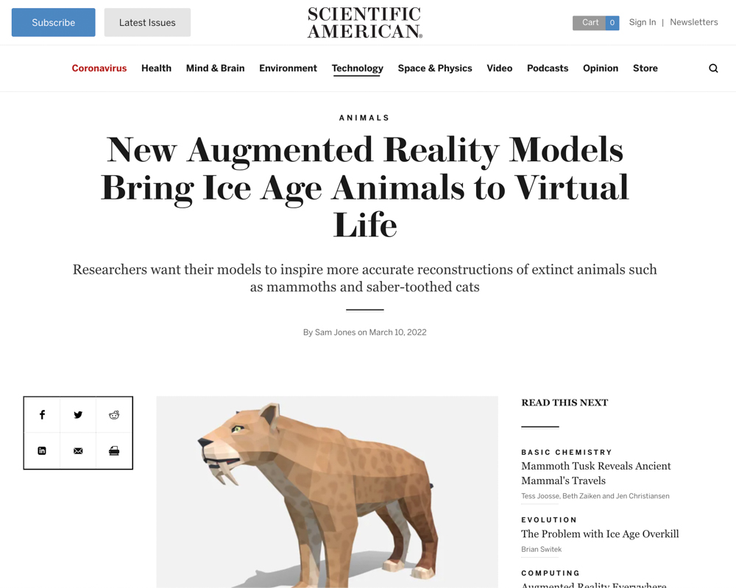
What USC Media Relations does for you
Promote peer-reviewed research to major news outlets
Seek opportunities for you, the expert, to be quoted by journalists
Guide you through other content possibilities, including social media, working with school teams, The Conversation
Media interview training
Notes:
EMILY
USC Media Relations is within University Communications. Central communications has one photographer, one videographer, one marketing professional, a graphic design and branding team, and editorial (USC News and Trojan family). About 30 people.
Media Relations is a team of six and we work with the president and the provost’s office to define university priorities. That helps determine how we deploy our staff.
In Media Relations we maintain a Public Information help line that is on-call in our office seven days a week.
The majority of USC’s media coverage is generated by professors providing commentary on their area of expertise.
Many of our calls, and much of our coverage, now comes from reporters reaching out to us director or stories they are working on. They often search for topics on Google and the USC Press Room.
EMILY - PressRoom.USC.edu is a website filled with the bios of USC professors who have agreed to lend their expertise to media outlets. This helps us, and reporters, find professors who can provide informed analysis.
But our gold standard is peer-reviewed research. We are always trawling for these studies before they are published.
We can also help with issues – as in, problems that ended up on a reporter's desk. If you get a call from a reporter and you feel uncomfortable, you can call us. We can help in a crisis. 213- 740-2215

Slide 3
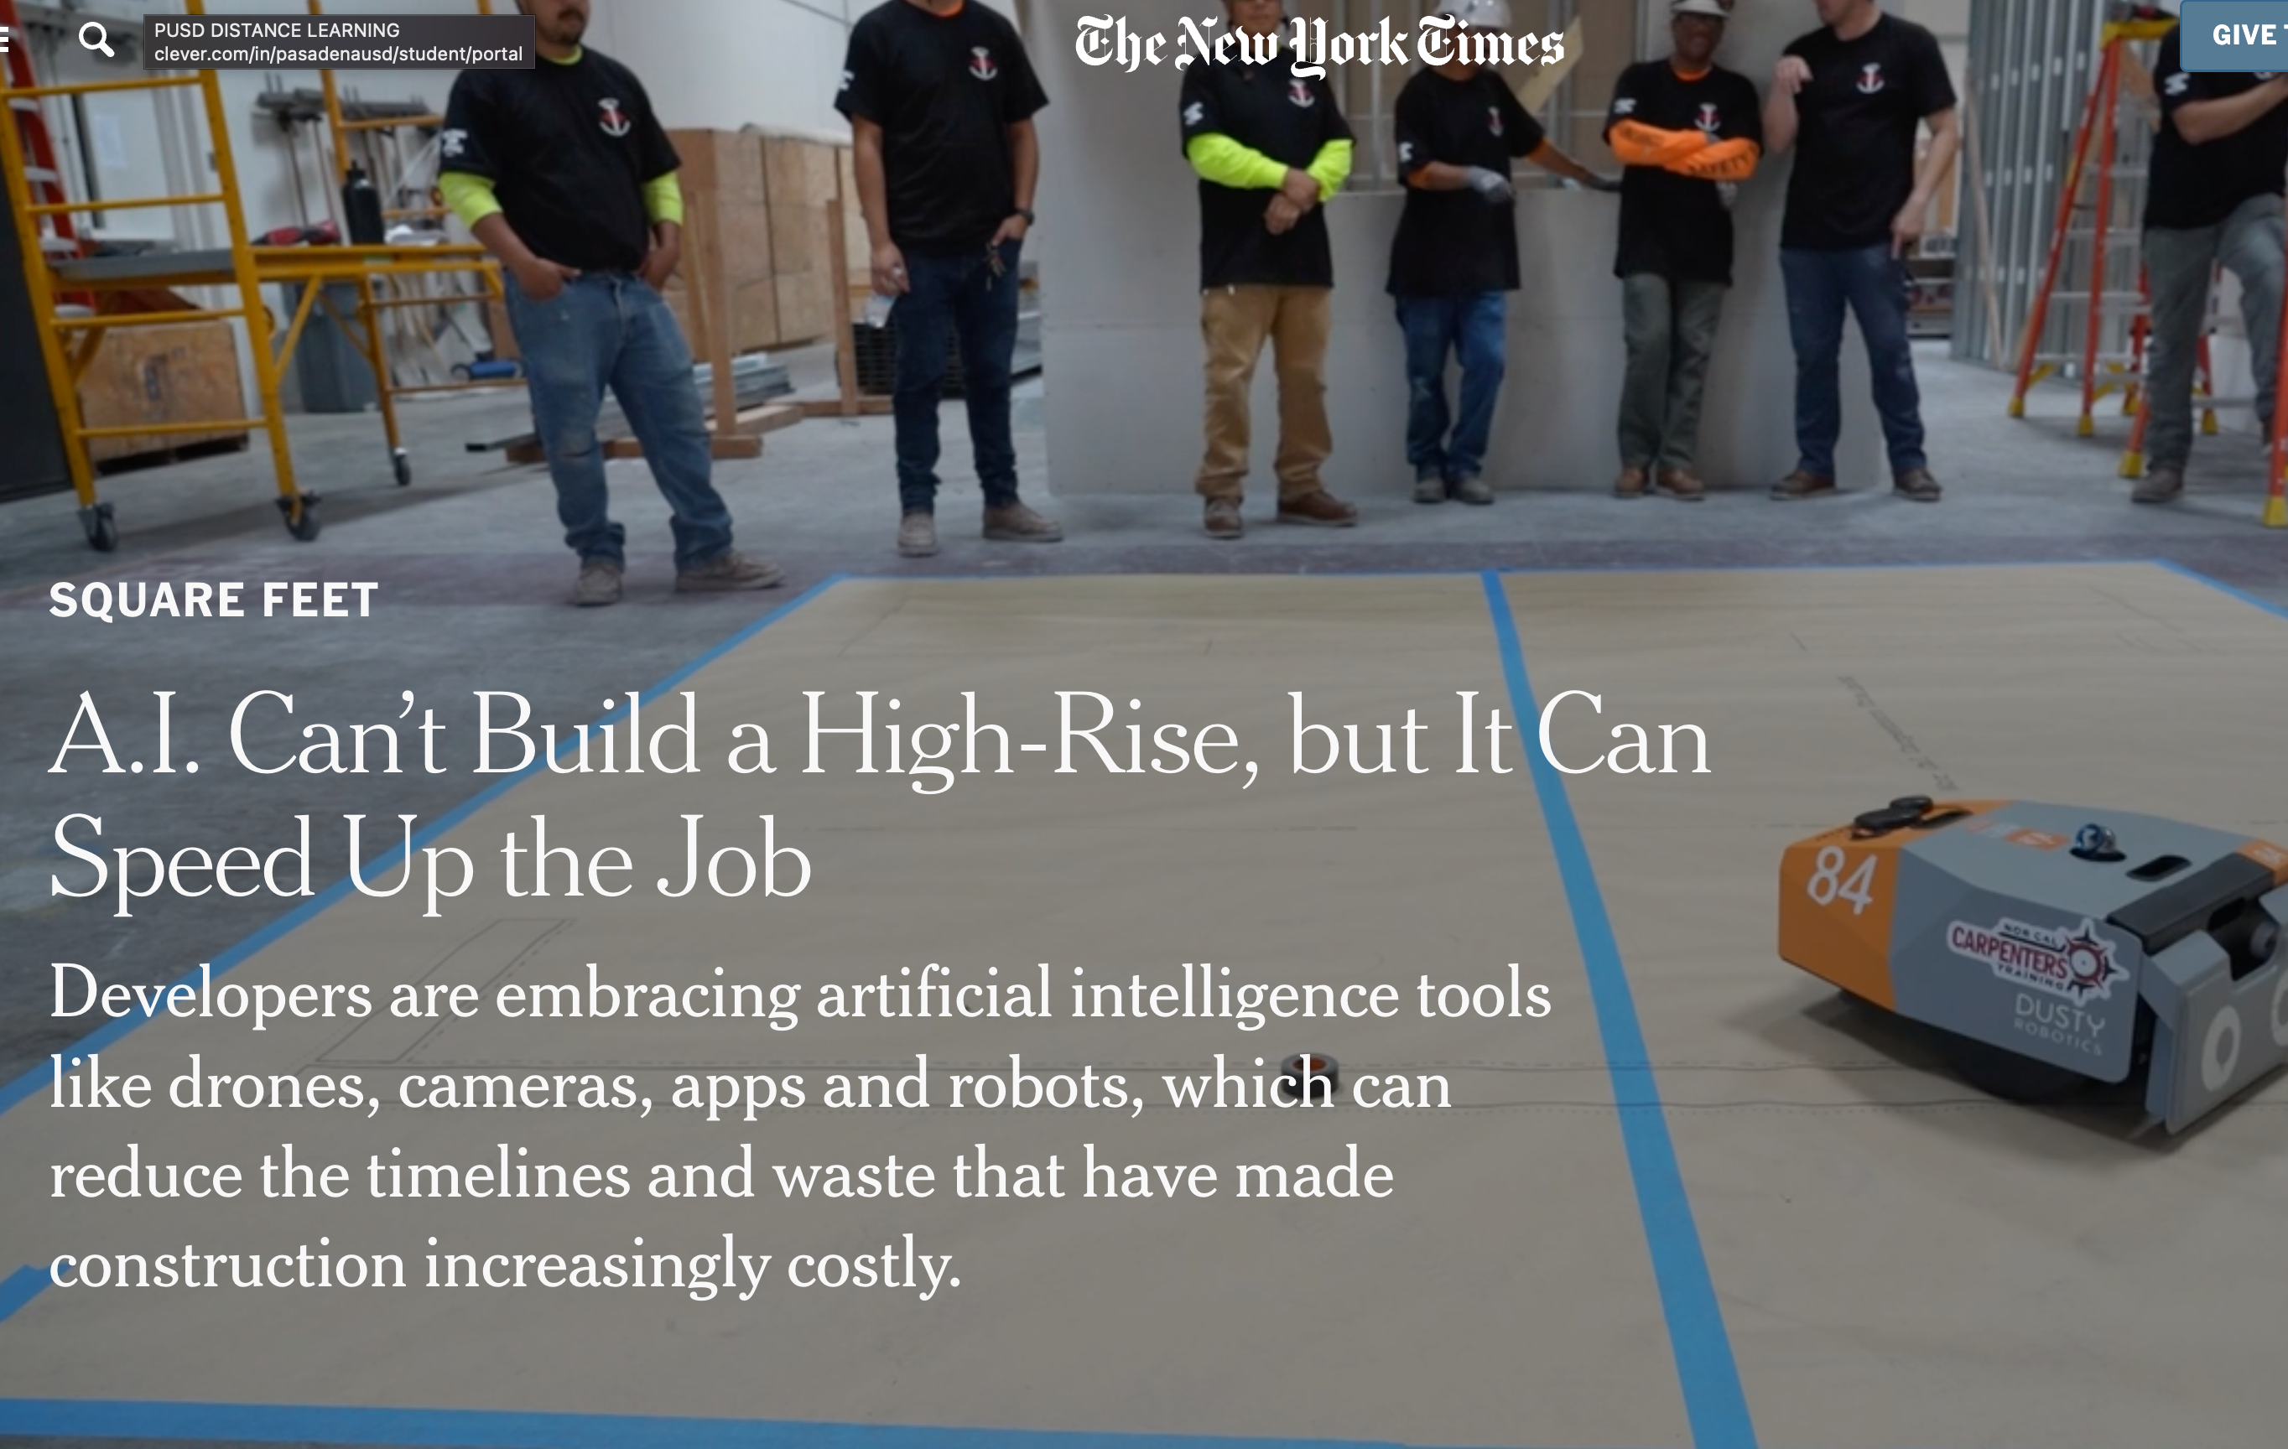
How we do it
Facilitate the university's relationship with media
Manage daily news media requests for expertise
Proactively look for opportunities where USC research and the news of the day intersect
Leverage efforts across many platforms, including USC social media accounts, AAAS's EurekAlert!, and AAU
Notes:
PAUL
We will give examples here like Source Alerts, op-eds, The Conversation, local and regional outlets, podcasts, EurekAlert!
If USC brand is behind it, we can assist – presidential priorities

Slide 4
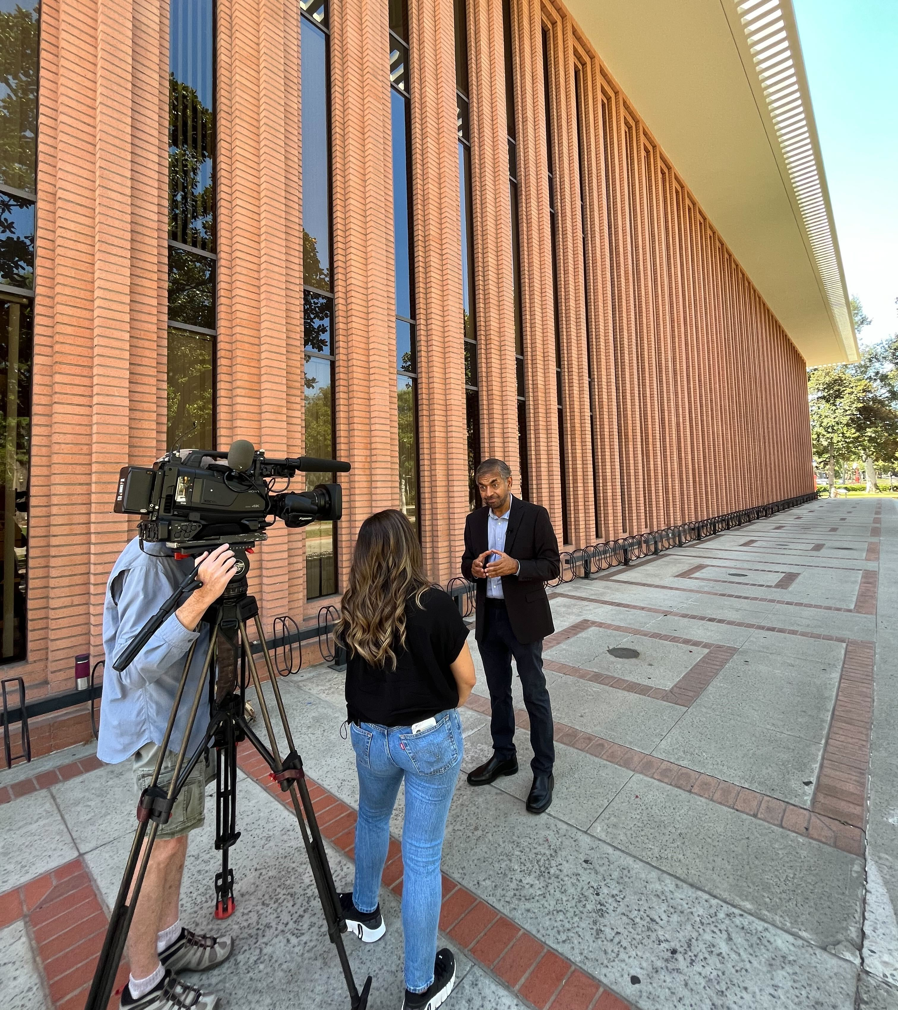
Who we reach
General public – local, state and national
Science and tech journalists
Peers via trade journal, EurekAlert!
Trojan community, supporters
Policymakers
Notes:
EMILY

Slide 5
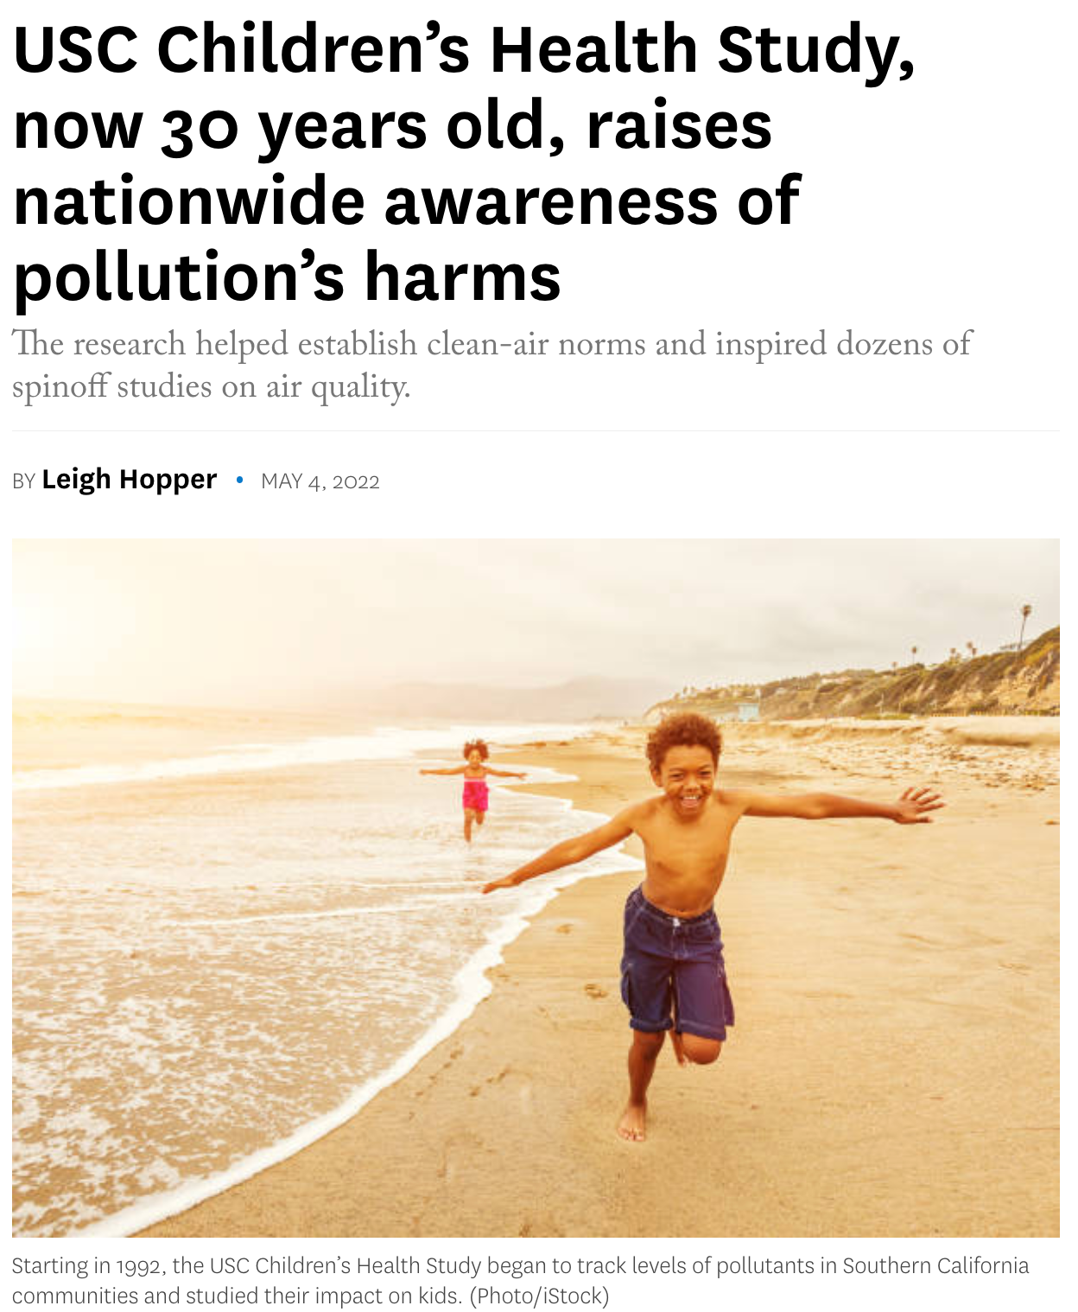
We are storytellers
Notes:
PAUL
Media placements
Outlets likes the WSJ and NYT position USC professors as experts and leaders in their field. USC professors or their research were cited in a top news outlet more than once a week last year.
But we don’t always have a newsworthy topics at hand.

Slide 6
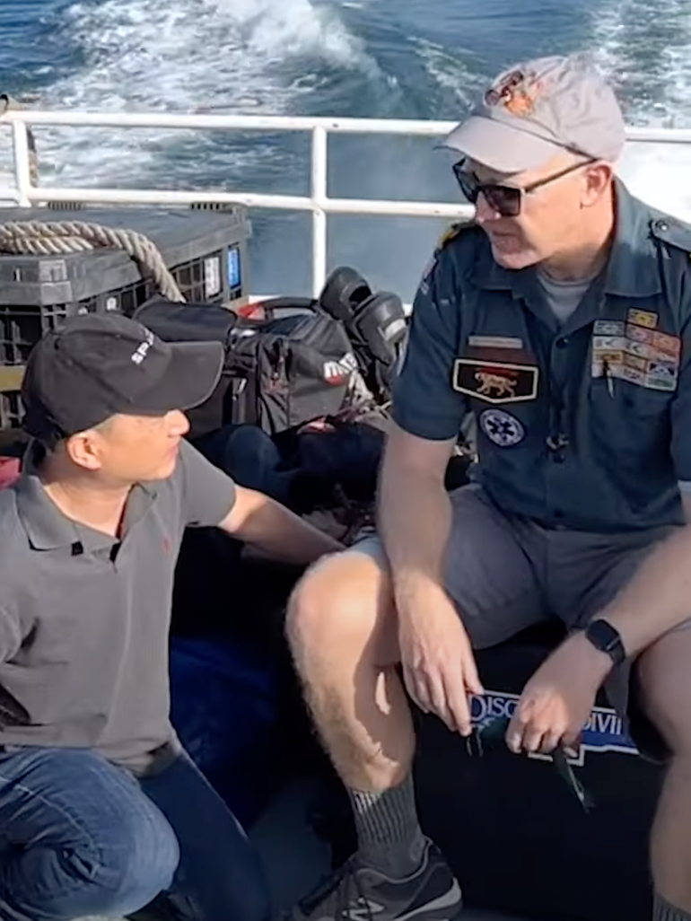
Tips for telling us your story
Be available.
3 main talking points (e.g.) What you found; why it matters; who it helps.)
Visuals – photos, graphics or videos can tell a story
Speak for yourself and your work.
If you have time, develop your profile by sharing your expertise on LinkedIn.
Build a rapport with us -- and the journalists we introduce.
Notes:
PAUL

Slide 7
Start working with us
Be an expert and join the USC Pressroom: http://pressroom.usc.edu
Tell us about your expertise
Invite us to visit your lab, witness a demo, see an experiment or attend a webinar
Not sure? Contact us: paulmcq@usc.edu, gersema@usc.edu

