Slide 1
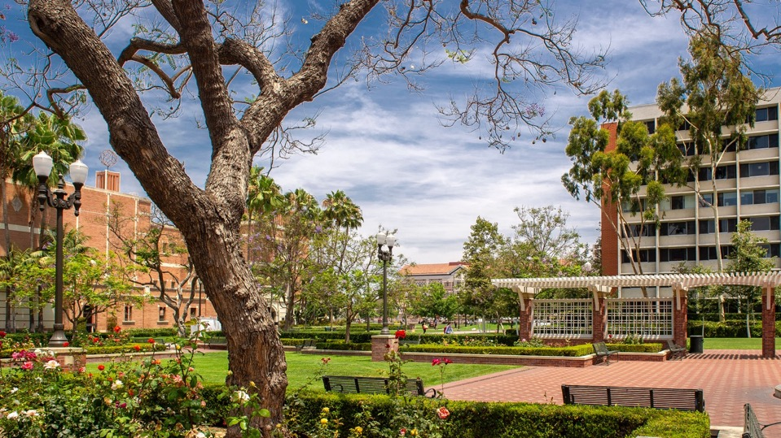
Human Research protection program (HRPP) Social behavior/biomedical IRbs
RoseAnn Fleming
08/18/2023

Slide 2
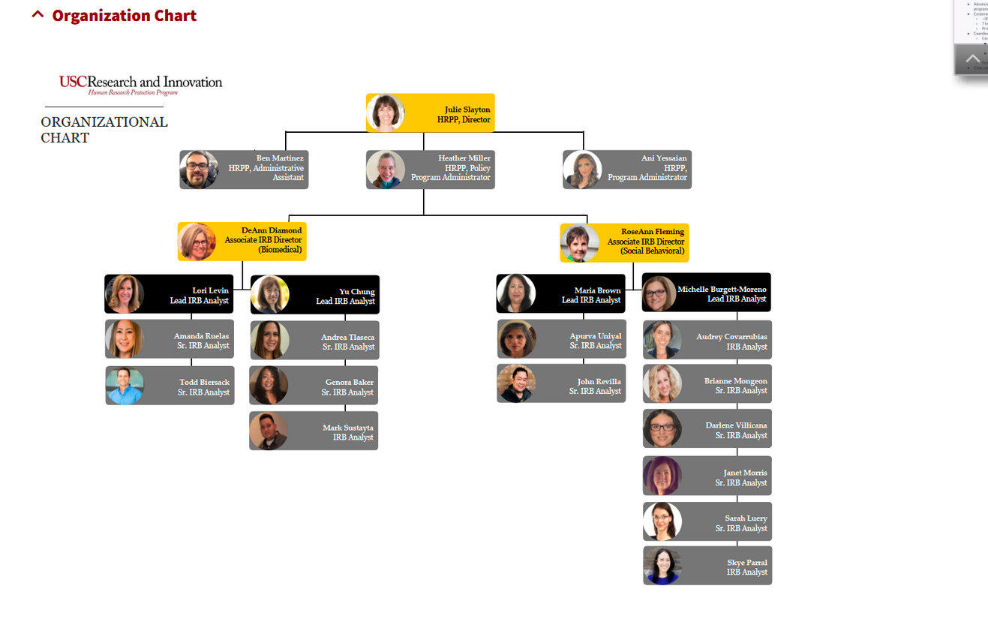
Org Chart

Slide 3
USC IRBs and partnerships
USC Biomedical IRB (BIRB)
Drug and Device/FDA
USC Social Behavioral IRB (SBIRB)
Surveys, observations, interviews.

Slide 4
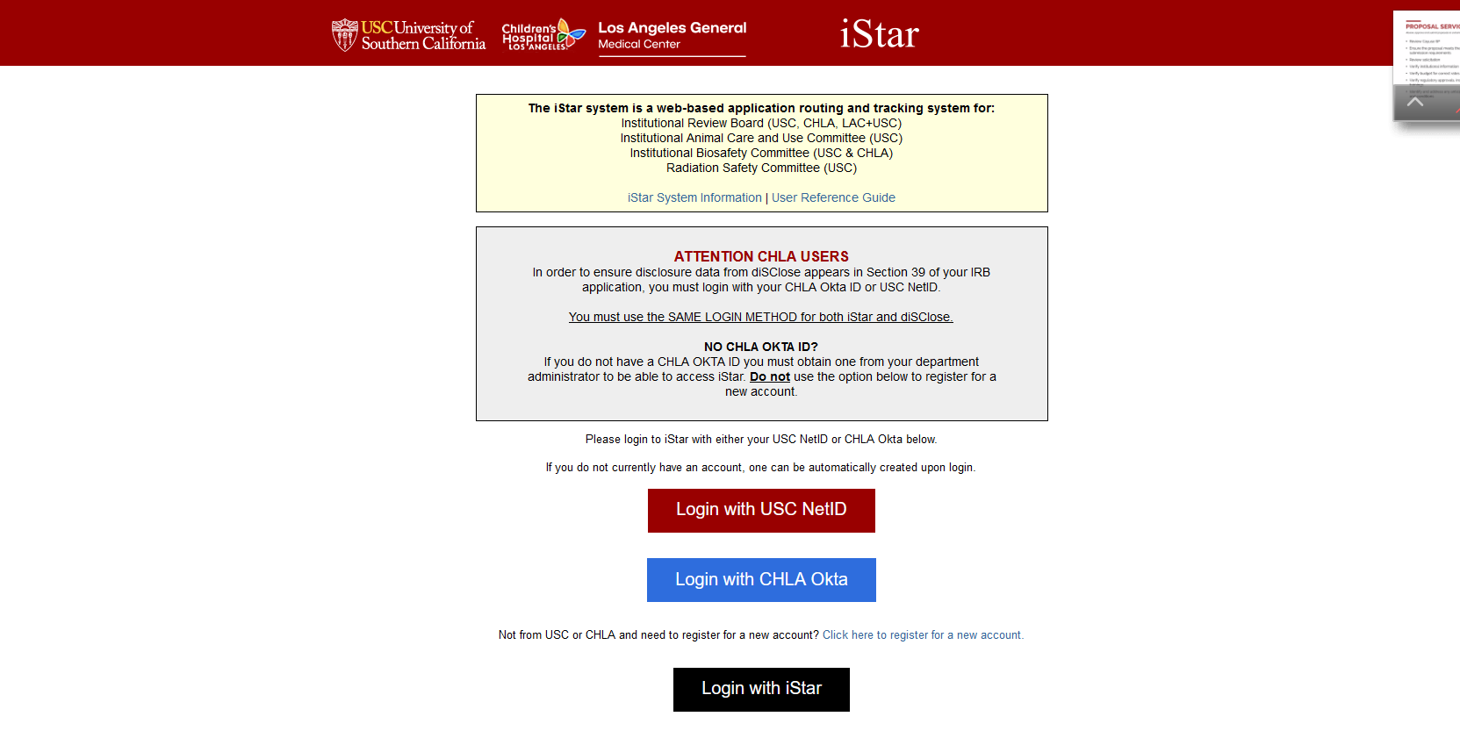
General Information

Slide 5
General Information
The Office for the Protection of Research Subjects formally changed their name to Human Research Protection Program
HRPP website (https://hrpp.usc.edu/) for regular updates regarding:
Submission process
Frequently asked questions
Templates
Ceded Review
Wait times for assignment to an IRB analyst for review

Slide 6
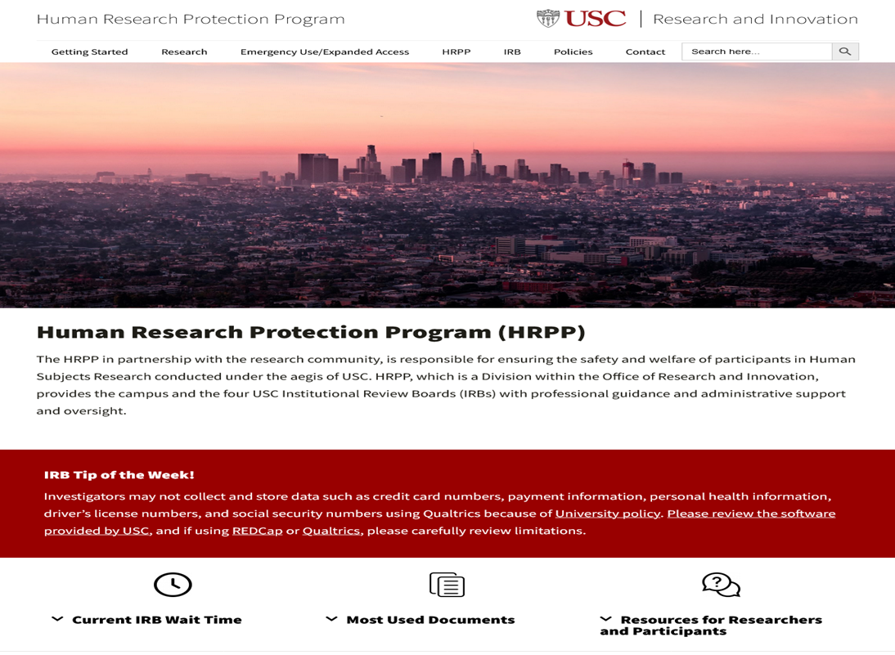
WEBSITE INFORMATION

Slide 7
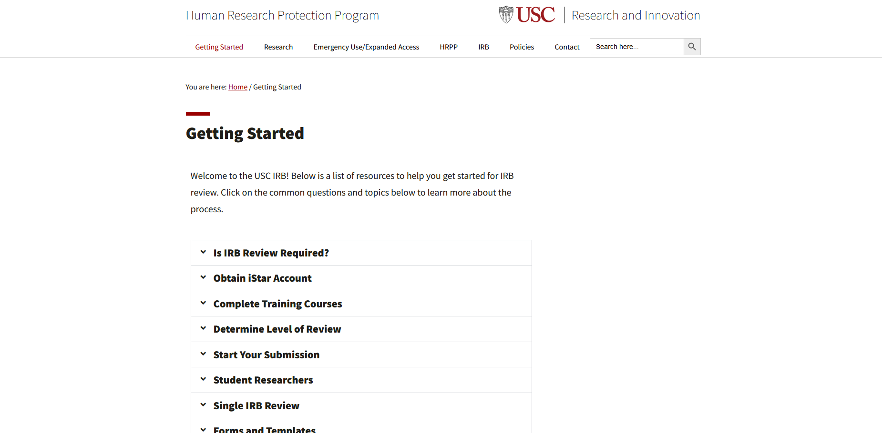
GETTING STARTED

Slide 8
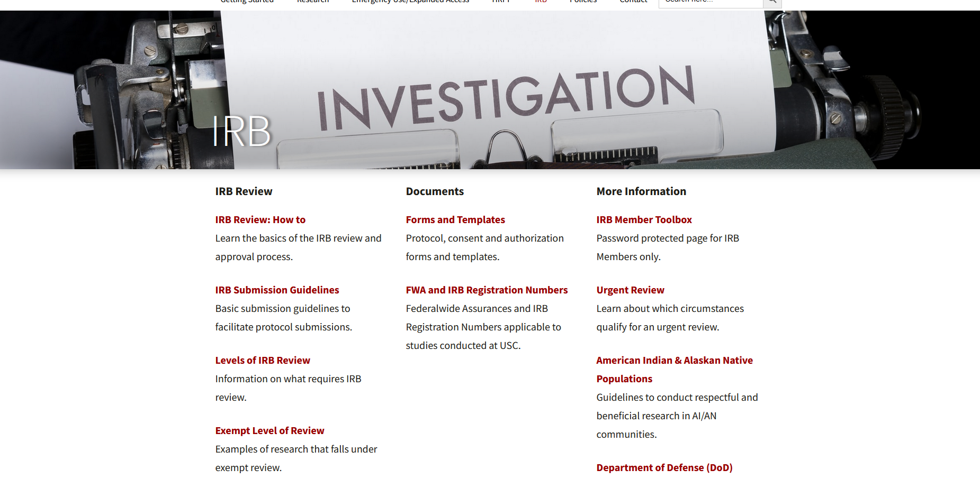
IRB PAGE

Slide 9
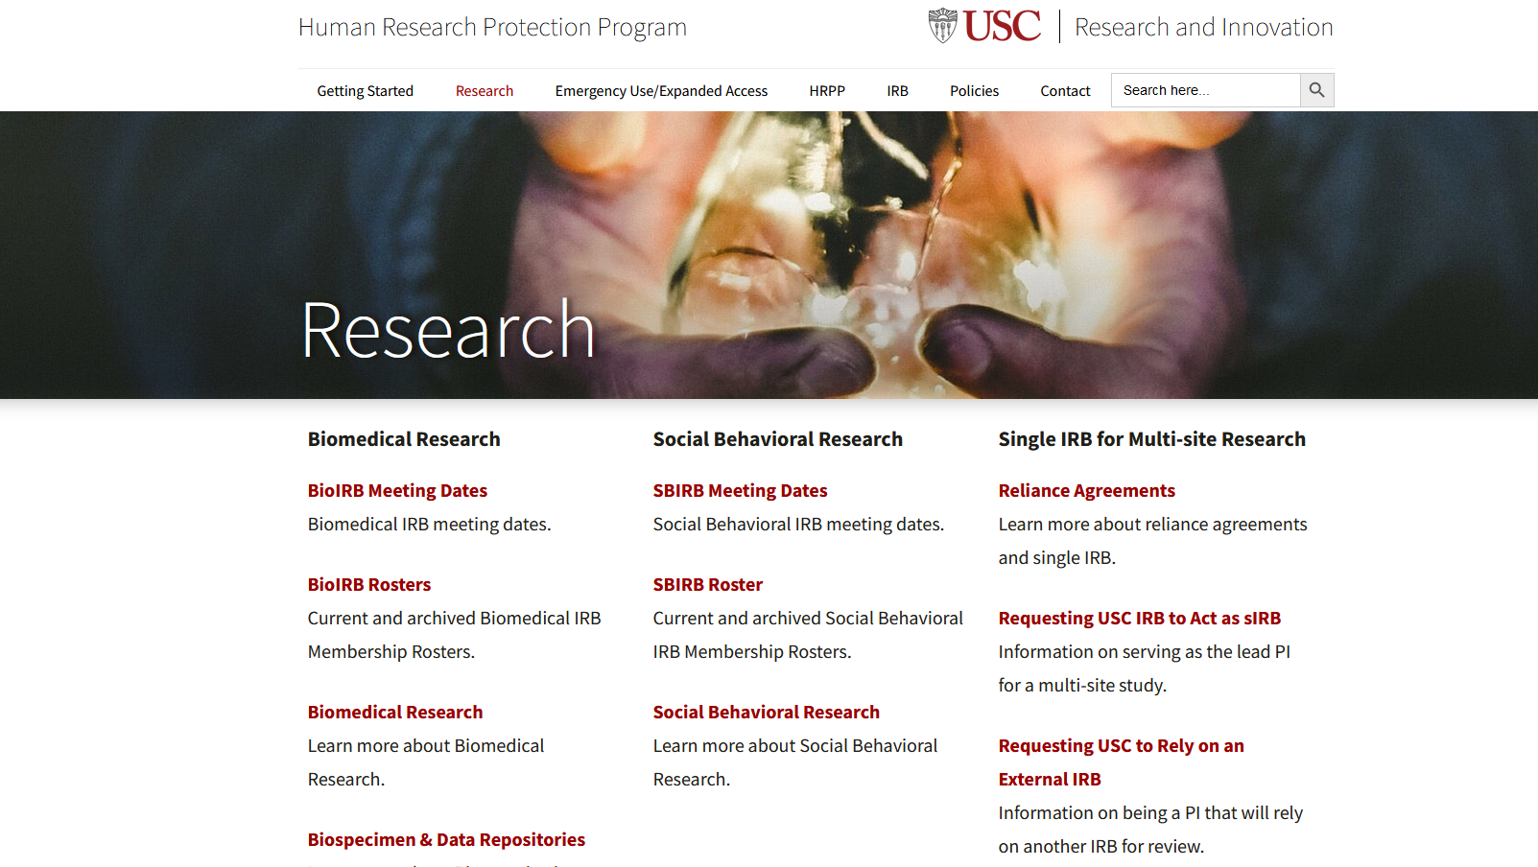
RESEARCH PAGE

Slide 10
Submission insights
Insights
Complete applications reduce delays in review
Language that can be understood by the reviewer
All information necessary for the reviewer to make a risk determination
All instruments that will be used for the study
Consent/permission/assent documents
All necessary additional information (e.g., SOP, Suicide Plan).
Clock starts ticking once the application has been submitted (signed off by all relevant parties) and not before
Timely response to contingencies and questions
1-3 business days
4 or more business days=return to the back of the queue

Slide 11
Follow up
Education and Support
iStar (https://istar.usc.edu)
iStar Tech Support (istar@usc.edu)
CITI (https://hrpp.usc.edu/training/citi/)
USC’s CITI Helpdesk (citi@usc.edu)
HRPP Contact (email, phone, Zoom)
Office hours (https://hrpp.usc.edu/virtual-office-hours/)
Tailored Ed Sessions for faculty and students

Slide 12
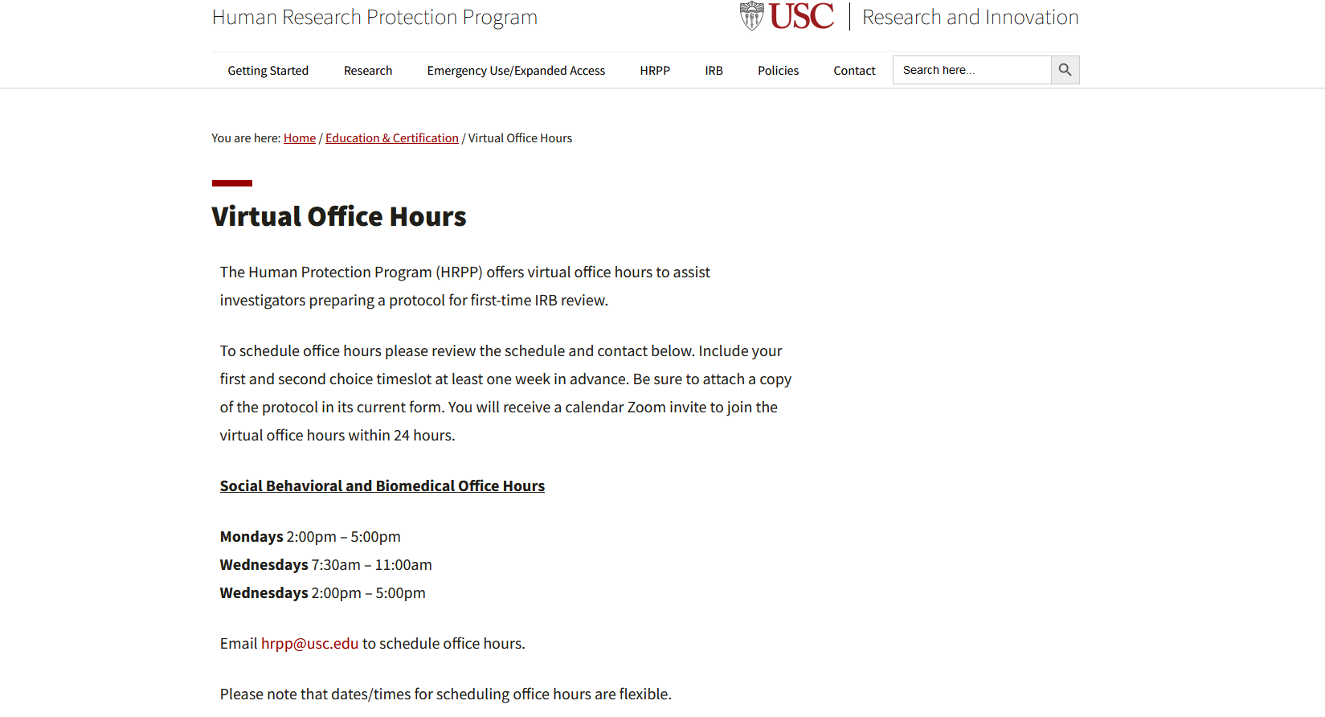
Follow up

Slide 13
contact names
USC IRBs & HRPP
hrpp@usc.edu
(323) 442 0114
Julie Slayton, JD, PhD.
Director HRPP
jslayton@usc.edu
Zoom: jslayton

Slide 14
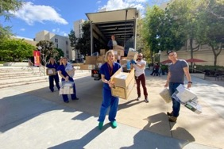
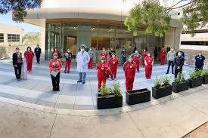
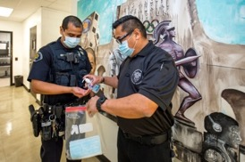
THANK YOU And good luck!

