Slide 1
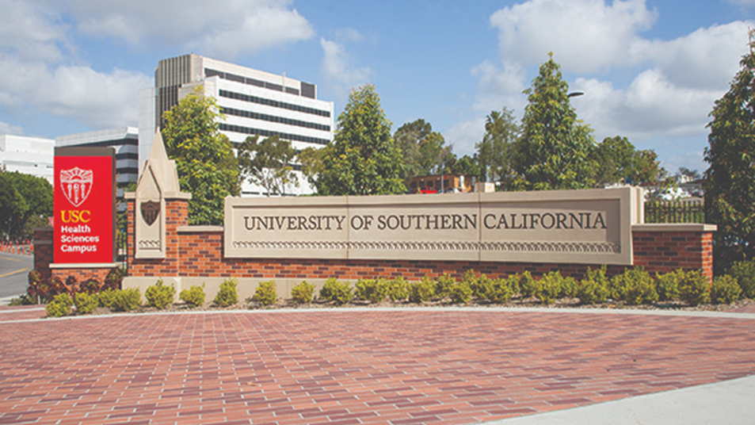
Navigating Laboratory Animal Research at USC
Navigating Research at USC 8/18/23
Dr. Ari Aycock-Williams DVM DACLAM
Executive Director
Department of Animal Resources

Slide 2
Content
Overview
Resources
Contact

Slide 3
DAR Mission and Vision Statement
DAR Mission Statement
To promote and provide the highest standards of animal care, use, and well-being to enhance life sciences research and education.
DAR Vision Statement To inspire investigators to strive for the best science through quality animal care, veterinary medicine, and research support.

Slide 4
Department of Animal Resources (DAR) our “Why”
We love animals and believe that they offer powerful solutions in our lives
4 licensed & accredited DVM
2 DACLAM
4 RVT
30+ ALAT, LAMA, LAT, RLAT
>15 different species
>1000 strains
6,890 Holding Units
7 facilities +4 satellite facilities
+2 future facilities
NIH.gov

Slide 5
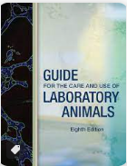
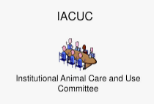
DAR ensures USC is Accredited, Registered, Licensed, Assured, and Certified
19th Institution
Continued Accreditation since 1966

Slide 6
DAR Services
Our #1 Priority: Provide daily animal care
Animal Husbandry
Cage Washing
Animal Health Care
IACUC Related Duties
Transportation
General Administration
Direct Billed Services
Training
Facilities Maintenance
Notes:
Daily Animal Care
Service animal rooms on a regular basis
Facilitate animal ordering and importation
Manage quarantine, outbreaks, and
Provide veterinary medical care
Provide research support services
Order supplies
AH: Animal Husbandry*
Maintaining a suitable environment for the animals: observation, watering, feeding, etc.
Record and census keeping
Daily enrichment that is administered colony wide
Cage changing
Cleaning
Disposal and sanitation of animal facilities that go above and beyond.
Includes any activity that is performed in addition to the everyday care of an animal that ensures a high level of animal care is being met.
Includes any time spent on animal facility mandated instruction for researchers or staff.
CW: Cage Washing*
Includes any activity associated with the sanitation of animal cages, cage racks and related activities that are done in cage washing rooms.
Includes the various tasks that are related to the prepping, setup, and autoclaving and/or sterilization of animal cages.
AC: Animal Health Care*
Veterinary medical care provided for the diagnosis, treatment and prevention of diseases/injury
Generally performed by Veterinary Services technicians
Training related to animal health care (non-IACUC)
IACUC: IACUC Related Activities*
The IACUC activity code should only be used by designated IACUC members when their time is being spent on specific IACUC committee related tasks. Such tasks may include:
Committee meetings
Semi-annual facility inspections
Semi-annual report writing
Protocol review
TSP: Transportation*
Time related to transporting animals between locations
GA: General Administration
Direction, control, and general management of the services
Paid breaks and lunch
Paperwork associated with the management of the species (example: USDA paperwork)
Staff and supervisor meetings
Training related to general administrative operations not including animal related activities
Software program training
Billing procedures
Non-animal care activities
Activities related to fixing or maintaining equipment needed to run the animal research center.
Checking in supplies from daily shipments.
Applies to Facility Technicians
DB: Direct Billed Services*
Includes any services which are billed for in addition the per diem rates.

Slide 7
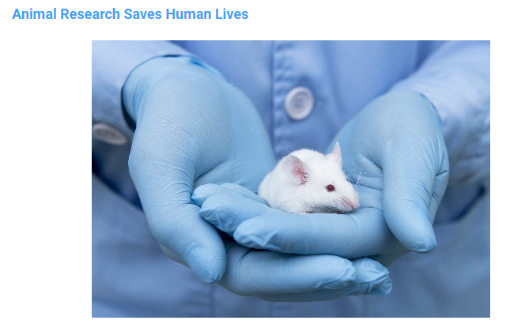
Contact
Main Office:
(323)442-1689
DAR Website
Dar.usc.edu
Purchases, Orders, Transfers, Exports, Service Requests, & Billing:
https://aops.usc.edu/
All Other Inquiries
daradm@med.usc.edu

