Slide 1
Research Computing & data services at USC
Center for advanced research computing (CARC)
BD Kim, PHD
Navigating research & scholarship at usc
August 18, 2023

Slide 2
About CARC
https://www.carc.usc.edu/
The computational expertise in high-performance computing of the USC Center for Advanced Research Computing (CARC) has been a vital resource in USC research community and contributes to improved research productivity and superior outcomes, driving USC’s research excellence forward.
CARC supports USC’s mission by providing advanced research cyberinfrastructure and the computational expertise necessary to enable cutting-edge scientific research.

Slide 3
CARC highlights
The resources, services, and achievements that set us apart.
Research Collaborations:
NSF Campus Compute ($400K) - Hybrid Computing System Development
NSF Regional Network ($1M) - Science DMZ R&E Network Deployment
NSF Regional Computing ($1M) – Leading Research Computing Alliance in SoCal
Cryo-EM project for USC & Amgen –Development of Computational Ecosystem
Education & Outreach:
More than 20 workshop classes and summer bootcamp
ITP 450: High-Performance Computing for Applied Machine Learning
NSF CyberTraining ($300K) – Computational Science curriculum development with AME faculty
Advanced Cyberinfrastructure:
Discovery shared HPC cluster system & Endeavour Condo cluster program
Artemis: virtual computing platforms and cloud solution (NSF Funded)
High-performance HPC network upgrade to 200Gbps
10+PB data storage capacity
Industry Partnership:
Samsung Semiconductor, Inc. – Full NVMe storage solution (2+PB)
VAST Data – Advanced FS testbed
Nvidia – Early access to Grace-Hopper next-gen system design & NSF proposal

Slide 4
Advanced research computing User services
The Center for Advanced Research Computing (CARC) offers comprehensive user support services
CARC
user
services
Social Media
news stories
Newsletter
CARC user tickets
Weekly office hours
Outreach
Tickets
Project mgmt
allocation mgmt
knowledgebase
User community engagement
User Forum
User Portal
Education
workshops
Video learning
Online Resources
User guides
System info
FAQ
https://www.carc.usc.edu/

Slide 5
CARC SystemS overview
CARC systems include the Endeavour condo cluster as well as the Discovery shared cluster
Endeavour (Condo Cluster)
Discovery (Shared Cluster)
Applications
Libraries
OS/System Tools
Login node:
endeavour.usc.edu
Login node:
discovery.usc.edu
56Gbps FDR IB
100Gbps
Data Transfer Nodes
hpc-transfer1/2.usc.edu
/home
100 GB/user
/project
8.5 PB
($40/TB/Yr)
/scratch1
1.8 TB
/scratch2
780 TB

Slide 6
HPC Resources
The following table summarizes the resources at CARC.
Category | Function | Descriptions
Discovery general-use cluster | Login nodes | 2 x 40 Gbps nodes
 | Data transfer nodes | 2 x 100 Gbps nodes running GlobusConnect
 | Compute nodes | ~600 nodes, totaling ~22,000 cores
 | GPUs | ~360 GPUs (A100, A40, K40, V100, P100)
 | Large memory nodes | 4 nodes with 1 TB of memory
Endeavour condo cluster | Login nodes | 2 x 40 Gbps nodes
 | Compute nodes | ~900 nodes, totaling ~22,000 cores
 | GPUs | ~180 GPUs (V100, A40, A100)
Network | Interconnection | InfiniBand FDR (56 Gpbs) – Soon to be upgraded to NDR
 | Science DMZ | DTN w/ perfSONAR
Storage file systems | /home1 | 280TB total, 100 GB/user ZFS/NFS parallel file system
 | /project | 9PB ZFS/BeeGFS parallel file system
 | /scratch1&2 | 2.6PB total ZFS/BeeGFS parallel file system
Artemis cloud platform | Compute nodes | 14 nodes, totaling 896 cores
 | GPUs | 6 x A40 GPUs
Recognizing the need for a significant upgrade in USC's current HPC infrastructure to meet the demands of future research, CARC is actively engaged in collaborative efforts with multiple departments across the university, focusing on planning and developing next-generation HPC systems that will deliver the necessary computing power to propel USC's research endeavors forward. These concerted efforts aim to provide optimal support for the the Frontiers of Computing initiative, ensuring that USC remains at the forefront of cutting-edge research and innovation.

Slide 7
USC research computing & data Road Map
The future of CARC looks bright with plans for future improvements, outreach, and collaborations.
01
03
Regional Cyberinfrastructure
Frontiers of Computing
Network Upgrade
Next-Gen
Supercomputer
CARC is building dedicated CI for under-resourced universities in the Southern California region.
CARC aims to provide optimal support for the the Frontiers of Computing initiative, ensuring that USC remains at the forefront of research and innovation.
We are in the process of upgrading our network to a 200 Gbps InfiniBand NDR low-latency interconnection.
This upcoming system will allow researchers to conduct large-scale AI modeling and simulations as well as traditional HPC research.
02
04

Slide 8
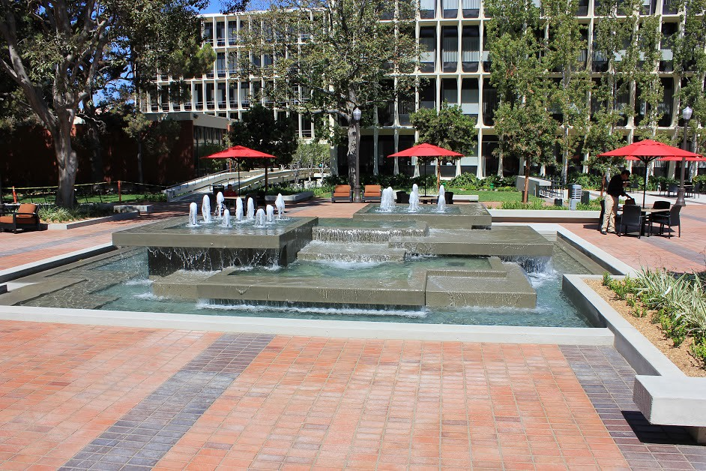
CCP: condo cluster program
The Center for Advanced Research Computing (CARC) launched the Condo Cluster Program (CCP) in December 2020 to allow researchers a flexible way to purchase computing resources for their own dedicated use.
The CCP has two pricing models:
Annual Subscription Model
Allows research groups to subscribe to their selected number of compute and storage resources on a yearly basis
Compute resources can be requested via CARC User Portal
Allocated nodes get provisioned automatically within a week
Traditional 5-year System Purchase Model
A useful option when research groups need to make a bulk purchase using a research grant or departmental budget
Compute/GPU system configurations by CARC
System purchases can be requested via CARC User Portal

Slide 9
State of the new condo cluster program
Current usage for CARC’s Endeavour condo cluster
# of projects:
# of nodes in use:
FY21-22 Purchase:
61
900
$660K
Contributions:
System utilization:
New nodes purchased:
Viterbi: 15 PI’s, 393 nodes
Dornsife: 26PI’s, 256 nodes
Keck: 13 PI’s, 131 nodes
Others: 2 PI’s, 3 nodes
- Not including subscription nodes
15K cores
180 GPUs
42 subscription nodes
257 old compute nodes will be decommissioned in FY24
18 CPU nodes
9 GPU nodes (12 x A40 / 12 x A100)
DOE cluster (18-node)

Slide 10
THANK YOU
& Fight On!

