Slide 1
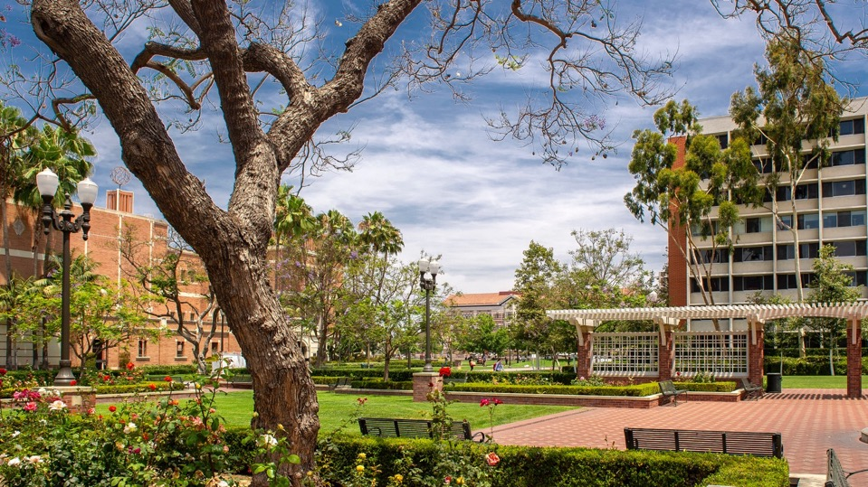
Proposal development & research support silvia da costa
Director, Office of research initiatives & facilities
August 20th, 2021
NAVIGATING RESEARCH &
SCHOLARSHIP AT USC
Friday, August 18, 2023
Silvia da Costa, PhD
Director

Slide 2
1
2
Section 1 / Research & Innovation Funding Programs - Grants
Section 2 / External Funding – Limited Submissions
contents

Slide 3
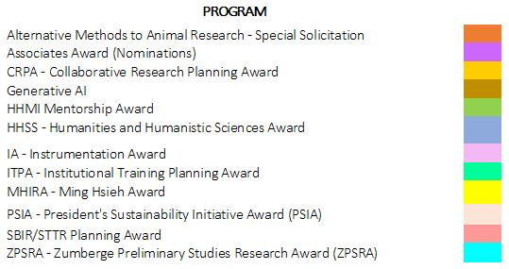
Section 1 / R&I Funding Programs - Grants
1
$7M in grants to be
awarded in FY24
Types: Research & Infrastructure Planning
Research
Technology Transfer
Creativity & Scholarship
Special Solicitations
Eligibility: Tenured, Tenured-track & RTPC Professors;
Part-time & visiting professors are not eligible
Aim: Support faculty proposal submissions to external sponsors
rii@usc.edu

Slide 4
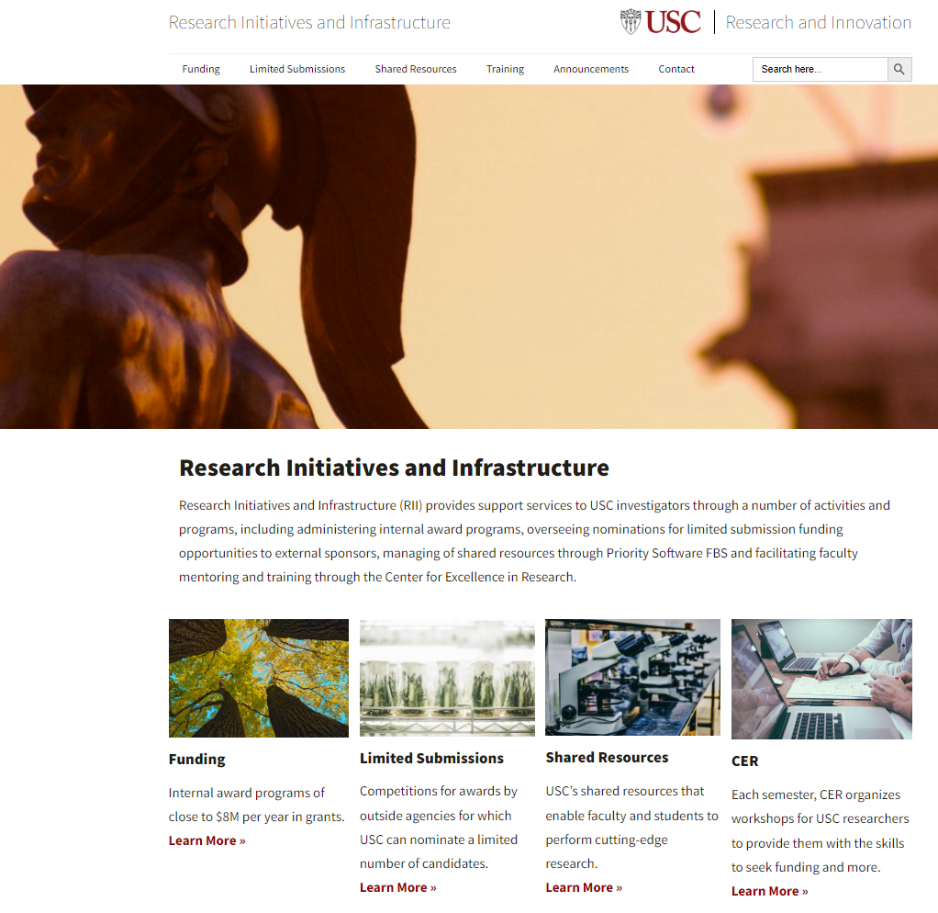
Section 1 / R&I Funding Programs - Grants
1
2
3
4
5
www.rii.usc.edu

Slide 5
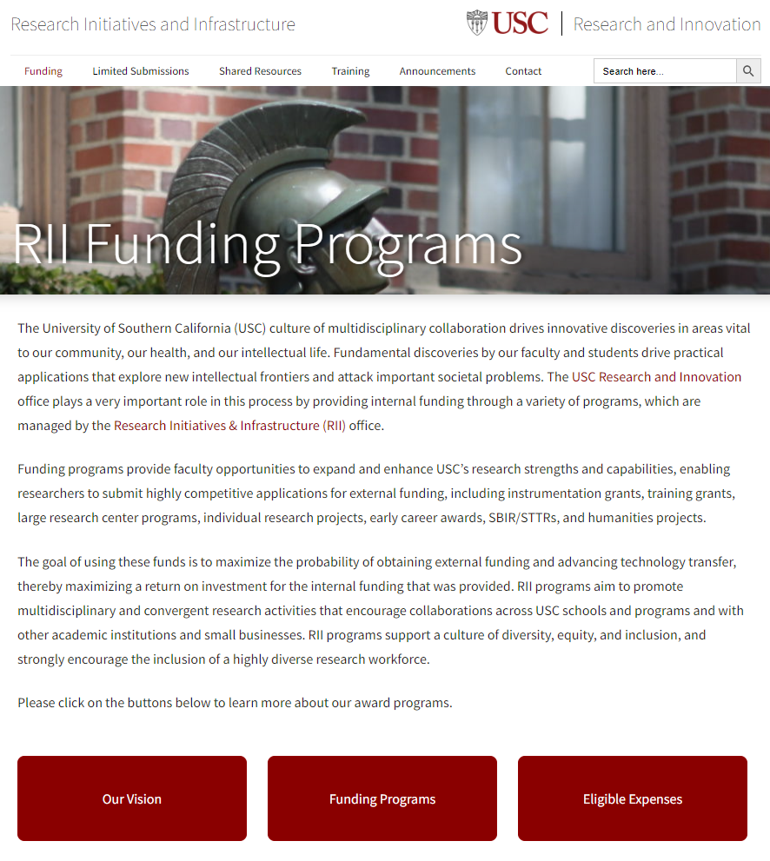
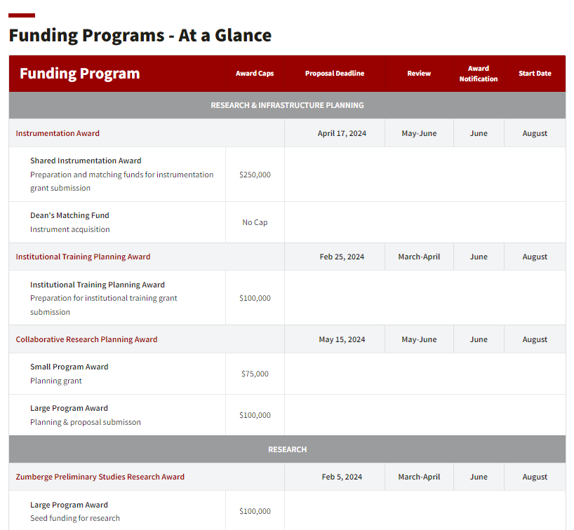
Section 1 / R&I Funding Programs - Grants
1

Slide 6
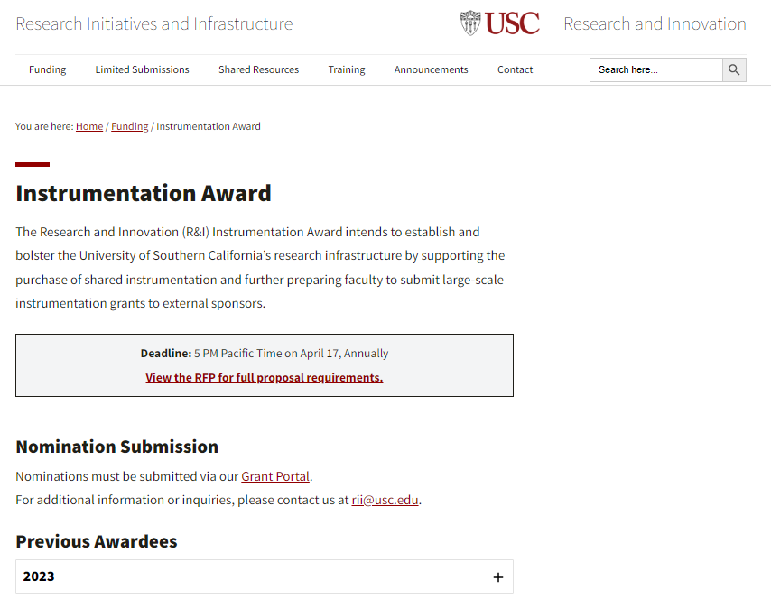
Section 1 / R&I Funding Programs - Grants
1
www.rii.usc.edu

Slide 7
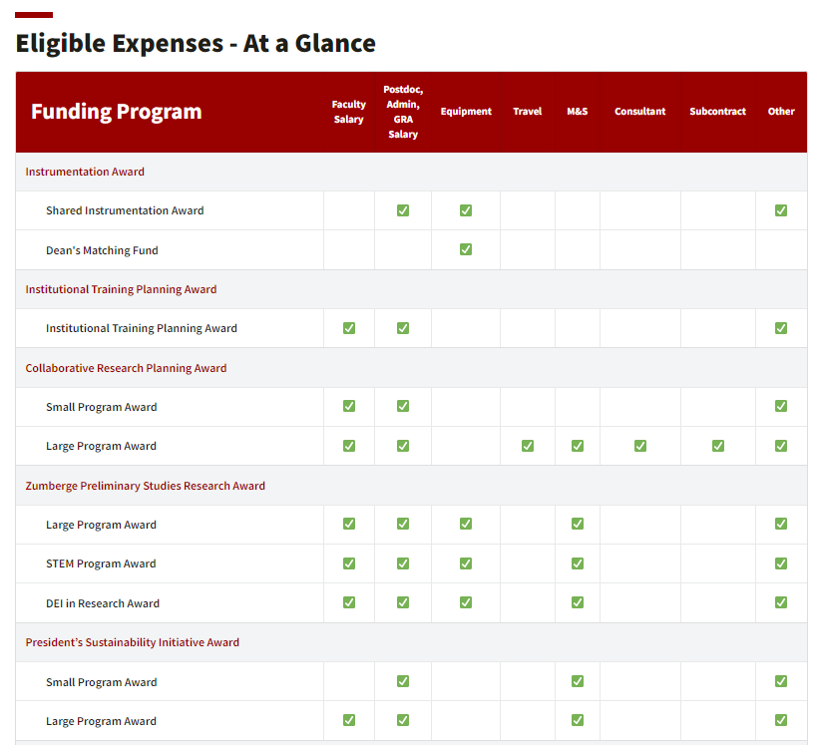
Section 1 /Internal Funding – Grants
1
www.rii.usc.edu

Slide 8
Section 1 / R&I Funding Programs - Grants
1
RESEARCH & INNOVATION FUNDING PROGRAMS
Research & Infrastructure Planning
Instrumentation Award (> $250,000)
Institutional Training Planning Award ($100,000)
Collaborative Research Planning Award
Planning ($50,000)
Planning & Proposal Submission ($100,000)
Research
Technology Transfer
Creativity & Scholarship
Special Solicitations
rii@usc.edu

Slide 9
Section 1 / R&I Funding Programs - Grants
1
RESEARCH & INNOVATION FUNDING PROGRAMS
Research & Infrastructure Planning
Research
Zumberge Preliminary Studies Research Award
Large ($100,000)
DEI ($50,000)
STEM (50,000)
President’s Sustainability Initiative Award ($50,000 - $250,000)
Howard Hughes Medical Institute Mentorship Award ($85,000)
Technology Transfer
Creativity & Scholarship
Special Solicitations
Ming Hsieh Institute Research Award
Translational Cancer Research ($150,000)
Pre-Clinical Cancer Research ($300,000)
Generative Artificial Intelligence (GenAI)
Building GenAI Research Networks ($100,000)
GenAI Research ($50,000)
Collaborative GenAI Research Award ($100,000)

Slide 10
Section 1 / R&I Funding Programs - Grants
1
RESEARCH & INNOVATION FUNDING PROGRAMS
Research & Infrastructure Planning
Research
Technology Transfer
SBIR/STTR Planning Award ($100,000)
Creativity & Scholarship
Special Solicitations

Slide 11
Section 1 /Internal Funding – Grants
1
RESEARCH & INNOVATION FUNDING PROGRAMS
Research & Infrastructure Planning
Research
Technology Transfer
Creativity & Scholarship
Humanities & Humanistic Social Sciences Award
HHSS Scholars Award ($110,000)
HHSS Initiative Award ($140,000)
Special Solicitations

Slide 12
Section 1 / R&I Funding Programs - Grants
1
RESEARCH & INNOVATION FUNDING PROGRAMS
Research & Infrastructure Planning
Research
Technology Transfer
Creativity & Scholarship
Special Solicitations
Alternative Methods to Animal Research Award ($125,000)
Replace
Reduce
Refine

Slide 13
2
Section 2 /External Funding – Limited Submissions
www.rii.usc.edu
If you identify an opportunity that is not listed on our site, contact us at rii@usc.edu and let us know about it!
Faculty cannot apply to a Limited Submission funding opportunity without RII nomination/approval – even if you identified it yourself.
Contact rii@usc.edu for additional info.

Slide 14
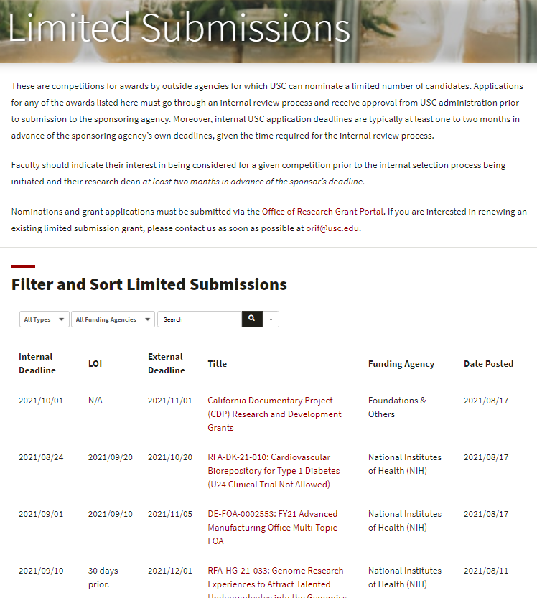
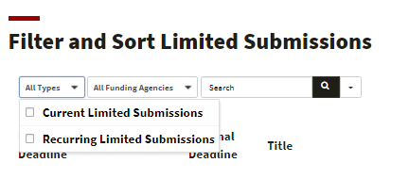
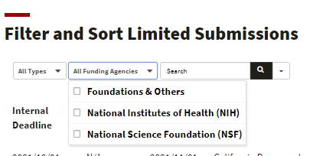
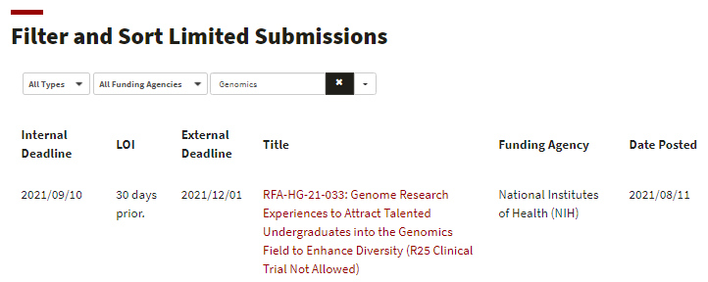
2
Section 2 /External Funding – Limited Submissions
Filter by type, funding agency or search term…
rii@usc.edu

Slide 15
Questions??
Contact us!
www.rii.usc.edu

