Slide 1
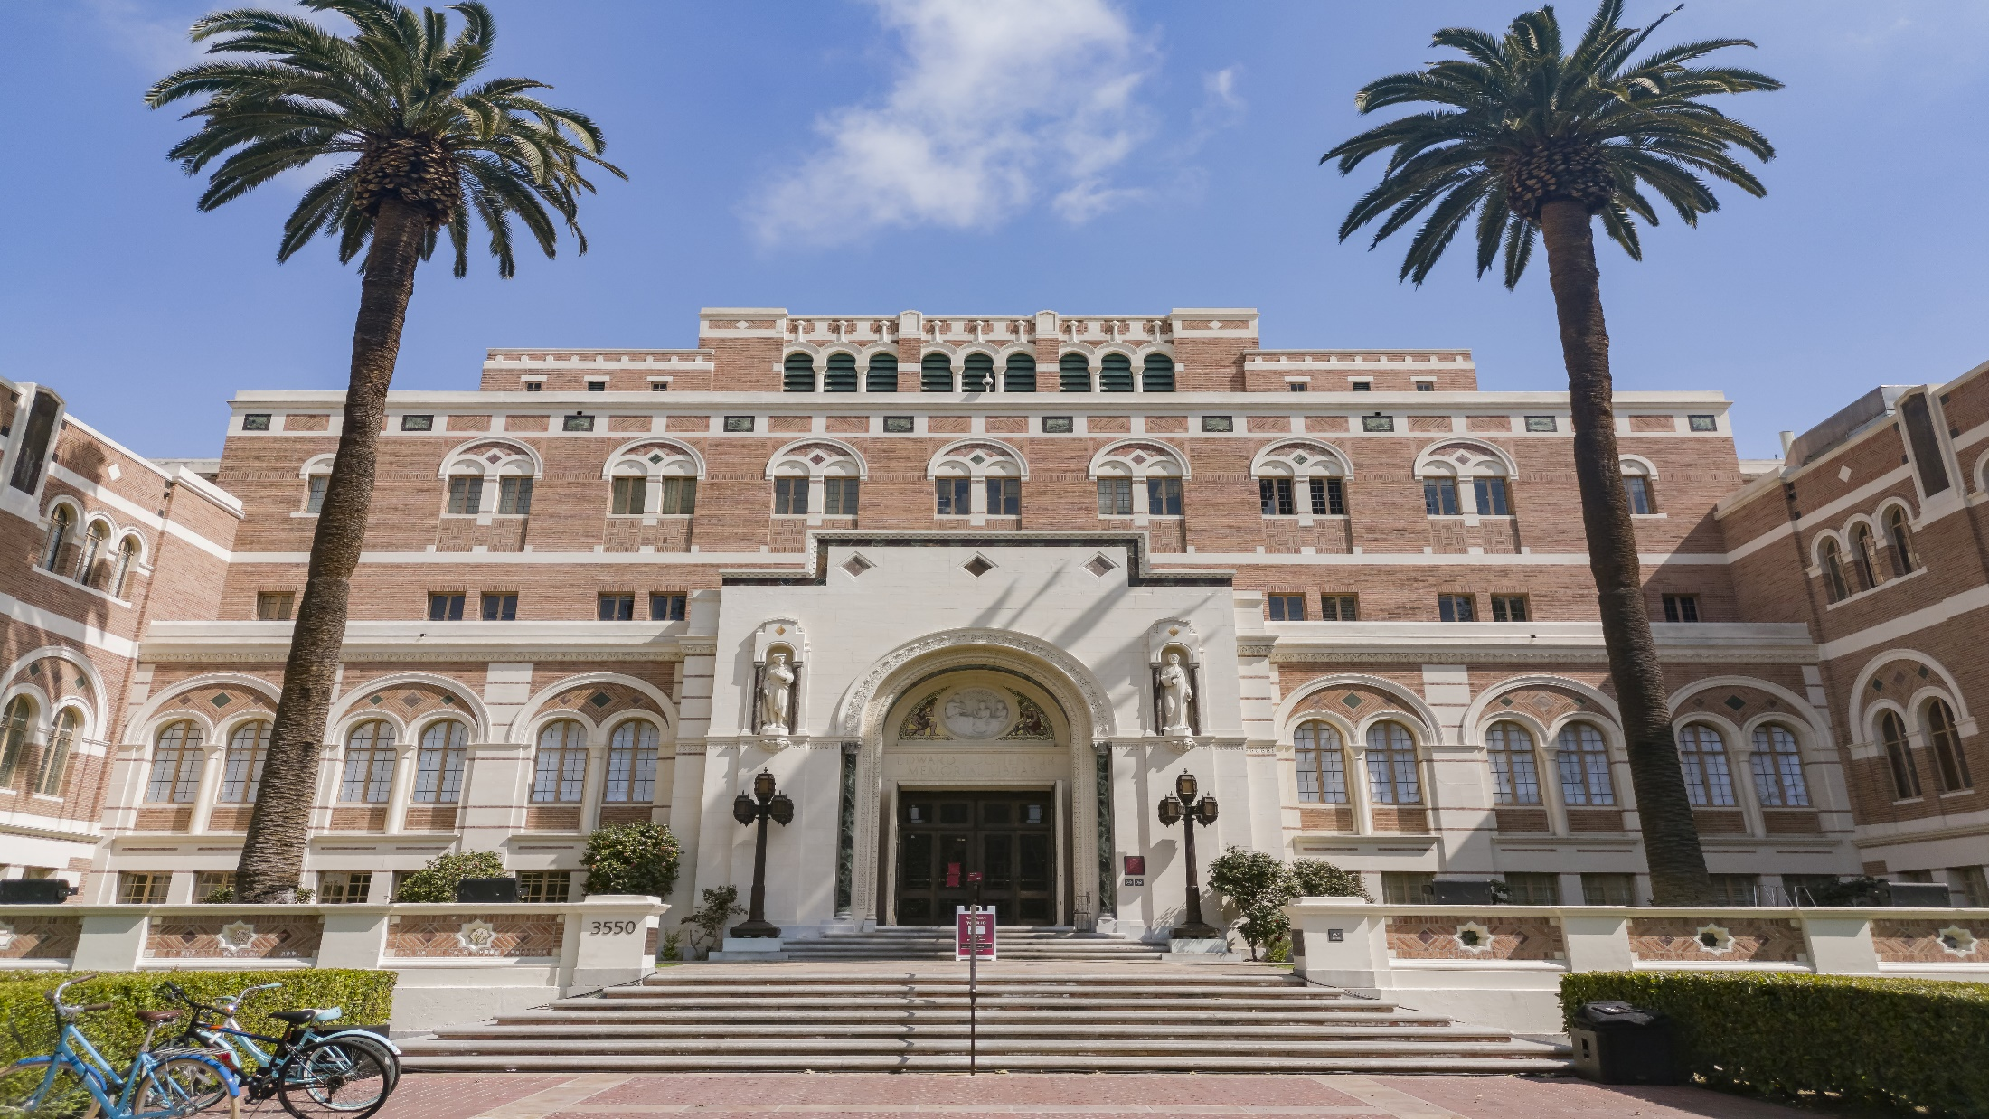
The department of contracts and grants
Navigating research at usc
August 19, 2023

Slide 2
contents
OVERVIEW OF DCG SERVICES
THE DCG TEAM
PROPOSAL SERVICES
AWARD SERVICES
POST AWARD SERVICES
TRAINING AND EDUCATION
1
2
3
4
5
6

Slide 3
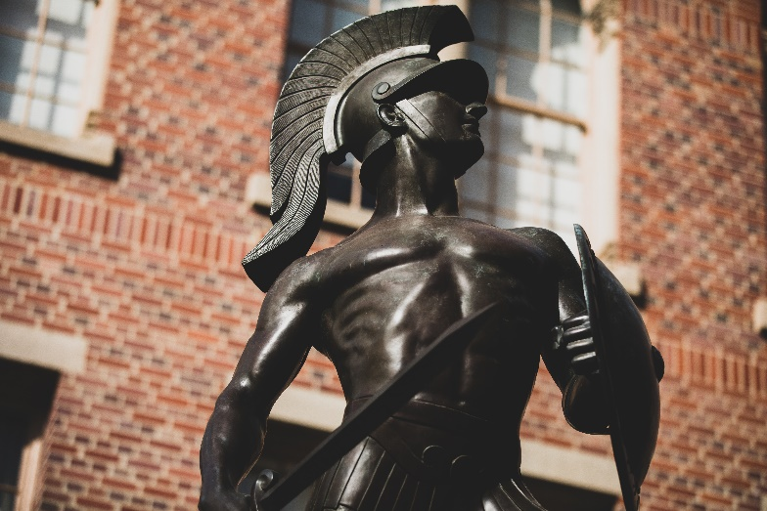
OVERVIEW OF DCG Services
Your Partner in Extramural Sponsored Activity, Excluding Industry Sponsored Clinical Trials
Proposal Review, Approval and Submission
Award Negotiation and Acceptance
Award Set-up
Subcontract Issuance, Negotiation and Acceptance
Training and Education
Develop and Maintain Positive Sponsor Relationships

Slide 4
The dcg team
https://dcg.usc.edu/contracts-and-grants-directory/
Three office locations
UPC –HSC
Marina: Information Sciences Institute (ISI) & Institute for Creative Technologies (ICT)
San Diego: Alzheimer’s Therapeutic Research Institute (ATRI)
Teams supporting School/Institutes
Centralized support
Award Establishment
Award Closeout
Training and Education

Slide 5
The dcg team
https://dcg.usc.edu/contracts-and-grants-directory/
Teams Organized by Sponsor Type & Department/Institute
Principal C&G Officers
Team Lead
Customer Service Point of Contact
Industry, State/Local Gov't, Int'l Sponsors & Special Agreements
Senior C&G Officers
Non-profit, University Sponsors
C&G Officers
Federal Sponsors
Federal Labs

Slide 6
PROPOSAL SERVICES
Review, approve and submit proposals to extramural sponsors on behalf of USC and PI(s)
Review Cayuse SP
Ensure the proposal meets the sponsor's submission requirements
Review solicitation
Verify institutional information
Verify budget for correct rates and cost sharing
Verify regulatory approvals, including any required trainings
Identify and address any anticipated award terms and conditions

Slide 7
PROPOSAL SERVICES:
enhanced proposal review
For final proposals submitted 3 days in advance of the sponsor's deadline, perform a comprehensive review
DCG will conduct a comprehensive review verifying:
Formatting: Font type and size, margins, page limits
Completeness for inclusion of all required sections
Budget calculations, rates and cost-sharing
Institutional information
Cayuse SP
Regulatory reviews and approvals, including any required trainings
Anticipated award terms and conditions

Slide 8
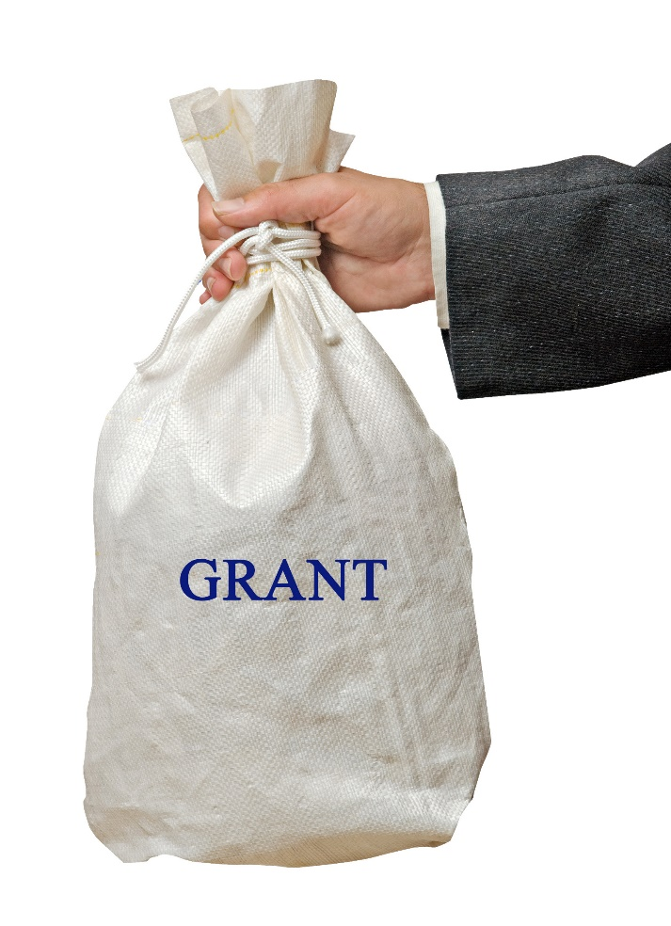
award SERVICES
Negotiate and Accept Awards on Behalf of the University
Appropriate classification of awards
Track negotiations
Provide Biweekly Updates
Discuss and Explain Any Exceptional Terms
Verify Regulatory Compliance (IRB, IACUC, IP-ACT, COI)
Award Set Up in Cayuse SP
Identify Award Information
Identify Key Terms and Conditions
Identify Prior Approval Requirements
Identify the Account Number

Slide 9
post-award SERVICES
Provide post-award support, including assistance with questions and issues arising during the performance of a sponsored project.
Interpret Terms and Conditions
Submit Prior Approval Requests
Issue, Negotiate and Execute Subcontracts
Review and Submit Supplements, Continuations, and Renewals
Facilitate Award Closeout

Slide 10
Training and DEVELOPMENT
Provide Training and Education to the Research Community
The C&G Curriculum
Grants Management Training (Faculty & Staff)
Cayuse SP Training
One-on-One Training (As Requested)

Slide 11
resources
DCG Website:
DCG Newsflash:
USC Offices Responsible for Handling Agreements
Roles and Responsibilities in Research Administration
Cayuse SP Guide and Training Materials

Slide 12
Communication and Planning Ahead are the key!
DCG Contact Directory
DCG Office Hours via Zoom: https://usc.zoom.us/j/98233041088
Wednesdays: 9-10 a.m.
Katie Rountree
Associate Director, DCG
rountree@usc.edu

