Slide 1

USC Research and Innovation Awards
to Fund Your Research
Silvia da Costa, PhD
Director
Research Initiatives & Infrastructure
Notes:
LOGO WILL CHANGE

Slide 2
Reorganization of the Office of Research
Office of Research
(OOR)
Ishwar K. Puri
Vice President of Research
Research and Innovation
(R&I)
Ishwar K. Puri
Sr Vice President of Research and Innovation & Professor
Other units reporting to OOR
Research Advancement
Washington DC
Steve Moldin
Executive Director
Office of Research Initiatives and Facilities (ORIF)
Silvia da Costa
Director
Other units reporting to R&I
Research Strategy and Development (RSD)
Steven Moldin
Associate Vice President of Research Strategy, Adjunct Research Professor
Research Initiatives and Infrastructure (RII)
Silvia da Costa
Director
Notes:
LOGO WILL CHANGE

Slide 3
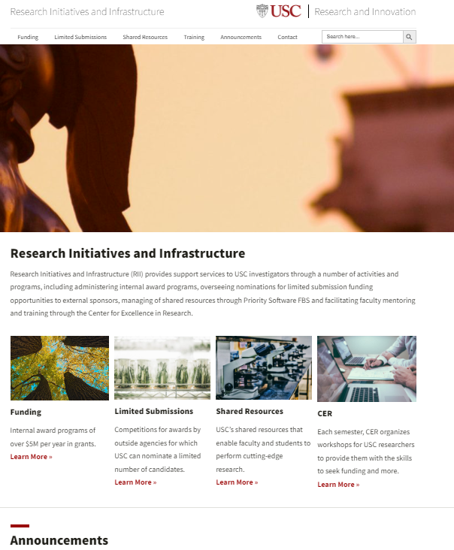
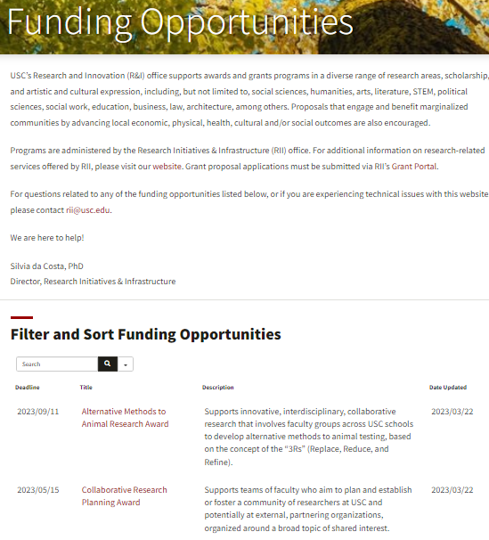
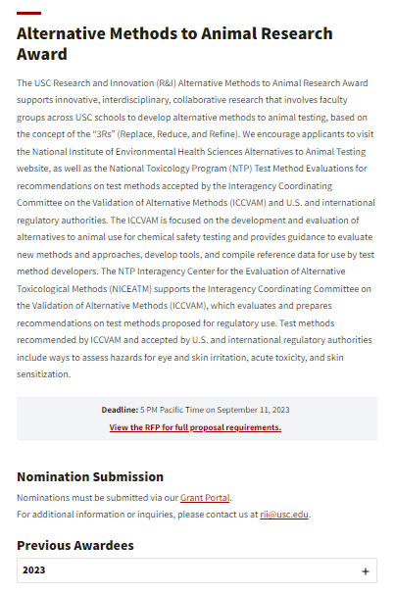
www.rii.usc.edu
Notes:
LOGO WILL CHANGE

Slide 4
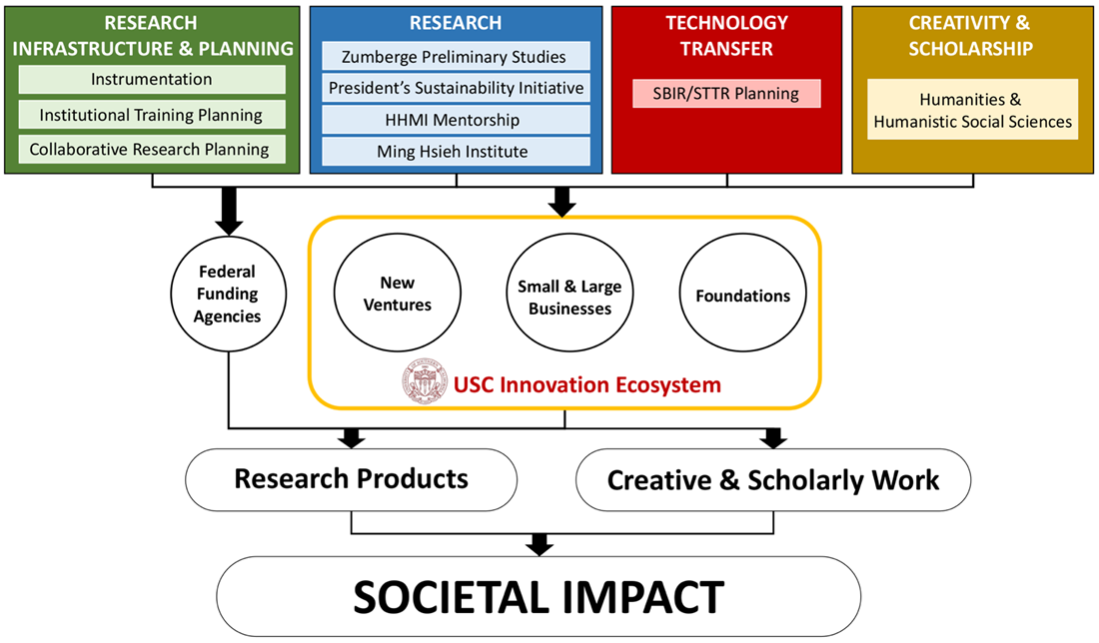
Research and Innovation (R&I)
Award Programs
IMPACT
Supports highly innovative research with benefits and relevance
for society
for the research community, advancing fundamental knowledge with the potential for broad impact in all areas of scholarship - biomedical, behavioral, social sciences, arts, communications, etc.
for support of USC research
Notes:
LOGO WILL CHANGE

Slide 5
Research and Innovation (R&I)
Award Programs
Ming Hsieh Institute Research Award (MHIRA)
Pre-Clinical
Translation Research Project
Ming Hsieh Institute Research Award
(MHIRA)
Pre-Clinical
Translation Research Project
Dean’s Matching Fund
Core Instrumentation
(Types A & B)
Instrumentation Awards (IA)
Shared Instrumentation Award
Dean’s Matching Fund
Zumberge
Individual
Interdisciplinary Large
Interdisciplinary Small
Diversity & Inclusion
Rose Hills (STEM)
Zumberge Preliminary Studies Research Awards
Small Award Program
Large Award Program
DEI Award
STEM Program Award
Notes:
LOGO WILL CHANGE

Slide 6
Research and Innovation (R&I)
Award Programs
NEW AWARD & GRANT PROGRAMS
President's Sustainability Initiative Award (PSIA)
Howard Hughes Medical Institute Mentorship Award (HHMI)
Humanities and Humanistic Social Sciences (HHSS)
Institutional Training Planning Award (ITPA)
SBBR/STIR Planning Award
Collaborative Planning Research Award
Provost’s Innovation Fund
Research & Development Priorities Award
Collaboration Fund
Special Solicitation
Alternative Methods to Animal Research (AMAR)
Notes:
LOGO WILL CHANGE

Slide 7
Research and Innovation (R&I)
Award Programs
Notes:
LOGO WILL CHANGE

Slide 8
Research and Innovation (R&I)
Award Programs
Notes:
LOGO WILL CHANGE

Slide 9
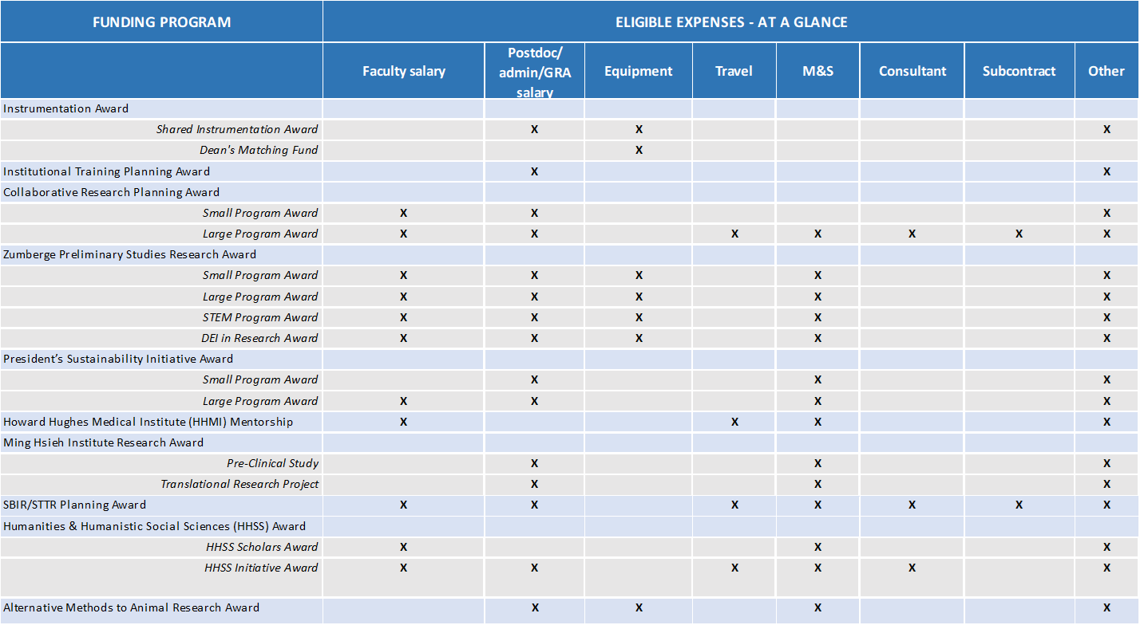
Research and Innovation (R&I)
Award Programs
ELIGIBLE EXPENSES – AT A GLANCE
Notes:
LOGO WILL CHANGE

Slide 10
Research and Innovation (R&I)
Award Programs
CONDITIONS OF AWARD
Cost Share: No caps – 50% provided by R&I – whether cost share, allowed by the sponsor, is required or not
Up to $50,000 (including fringe) for salary support to Research Administrators
The program deadlines are not matched to federal funding program deadlines in a given calendar year. You can apply to a program in advance of federal funding deadlines, for submission to the next year’s deadlines
Failure to spend at least half of the awarded funds within six months of the project start date may result in the suspension of the remaining funds.
Any and all grants, publications, presentations, etc., arising from research supported under the R&I award program must acknowledge the USC Research and Innovation [award program name].
Notes:
LOGO WILL CHANGE

Slide 11
Research and Innovation (R&I)
Award Programs
CONDITIONS OF AWARD
RETURN ON INVESTMENT - FUNDING TARGETS
It is expected that projects funded will yield a return on investment of at least 10 times the funding received for an application submitted to this Request for Proposals.
For example, proposals requesting $50,000 in funding from this opportunity would need to identify future funding award program by federal agencies or other external sponsors, which was enabled by the inclusion of preliminary data and publications generated through this award, and that will generate a cumulative awards of $500,000 or more (this includes total costs summed over all award years).
Award applications focused on the areas such as arts, return on investment is not defined in terms of future funding. Rather, R&I views return on investment as developing and enhancing the reputation of our faculty as nationally recognized artists who will have a significant creative impact on society and their field.
Notes:
LOGO WILL CHANGE

Slide 12
Ming Hsieh Institute Research Award
(MHIRA)
FOCUS
The Ming Hsieh Institute Research Award (MHIRA) award support impactful translational and pre-clinical research that drives innovation, bridging science, engineering, computing, pharmaceutical sciences, and medicine to expedite the bench-to-bedside development of new life-saving devices and therapeutics to detect and/or treat cancer.
There is a strong interest in proposals that will initiate multi-disciplinary research teams employing or lead by engineering, computing, AI and machine learning, computational biology, physics, chemistry, genetics, pharmacology, and/or medicine and biological sciences.
Each proposal must have a team of two or more USC faculty principal investigators. The team of PIs/co-PIs must hold primary faculty appointments in at least two different USC schools.
The breakthroughs developed by Ming Hsieh Institute Research Award interdisciplinary projects are designed to be translated directly into advances in patient cancer care and catalyzed into inventions that can be licensed and commercialized.
Notes:
LOGO WILL CHANGE

Slide 13
Ming Hsieh Institute Research Award
(MHIRA)
MHIRA PROGRAMS
PRE-CLINICAL STUDY
Scientific work where a clinical perspective informs and guides research toward medical solutions.
Teams must include a lead PI from engineering, computing, AI/machine learning, computational biology, physics, chemistry, biology, molecular biology, and/or other biological related sciences, partnered with biomedical researchers that may also include pharmacy and dentistry.
Teams must include at least one physician (MD), as a co-PI or in an advisory/collaborator role, and whose current clinical practice includes serving patients in the area of cancer for which the research is proposed.
Awards of up to $150,000 (one year award)
Notes:
LOGO WILL CHANGE

Slide 14
Ming Hsieh Institute Research Award
(MHIRA)
MHIRA PROGRAMS
TRANSLATIONAL RESEARCH PROJECT
Scientific work in which already developed technologies or therapies are married with clinical patient populations for human testing as a step toward a specific commercialization goal.
Teams must include a lead PI physician (M.D. or MD, PhD) whose current clinical practice includes serving patients in the area of the specific disease for which the research is proposed.
We seek multi-disciplinary research teams that partner researchers with engineering, computing, AI/machine learning, computational biology, physics, chemistry, biology, molecular biology, and/or other biological/biomedical related sciences.
Awards of up to $200,000 - $300,000 (one year award)
ROI also includes potential licensing/IP.
Notes:
LOGO WILL CHANGE

Slide 15
President’s Sustainability Initiative Award
(PSIA)
FOCUS
Integrating sustainability as a core value in USC’s strategic planning is a critically important institutional commitment.
The President’s Sustainability Research Award will provide seed funding to enable researchers to submit highly competitive applications for federal funding, including large center and related programs, early career awards, and individual research projects. The goal of using these funds is to maximize the probability of obtaining federal research support for the proposed effort.
TOPICS
Topics for this Request for Proposals are listed below in bold. Suitable projects within each topic include but are not limited to the following examples:
Human Health and Well-Being
Infrastructure and Built Environment
Natural Environment/Ecosystem Services
Communications, Policy & Institutions
Risk Analysis and Economic Impacts
Notes:
LOGO WILL CHANGE

Slide 16
President’s Sustainability Initiative Award
(PSIA)
PSIA PROGRAMS
SMALL PROGRAM AWARD
Supports research projects of smaller scale in the formative stages of development or being conducted at the individual level
LARGE PROGRAM AWARD
Supports larger-scale, collaborative research projects involving multiple investigators, schools, and/or departments.
Proposals received for FY24 award: 25 - Currently under review (7 for Large; 18 for Small)
Notes:
LOGO WILL CHANGE

Slide 17
Instrumentation Award (IA)
IA PROGRAMS
SHARED INSTRUMENTATION AWARD
Provides support for generating a competitive proposal submitted to a federal funding agency or other external sponsor (proposals that target federal funding agencies are of greatest interest).
Supports up to $50,000 in personnel costs (including fringe), other expenses. Personnel supported under this award will work specifically on proposal preparation, and not on research activities.
Can request up to 50% cost share (no caps), whether required or not, with the remaining 50% being funded by a federal agency or other external sponsor.
Instruments purchased with funding from the Instrumentation Award Program are expected to be placed at a USC Core Facility. If USC Core Facility, a justification must be included in the Instrumentation Plan detailing where it will be placed, how it will be maintained as well as how it will be made accessible and shared with USC researchers
Notes:
LOGO WILL CHANGE

Slide 18
Instrumentation Award (IA)
IA PROGRAMS
DEAN’S MATCHING FUND
Fund supports the direct and immediate acquisition of instrumentation by awardees.
Supports up to a 50-50 match for instrumentation acquisition, with R&I funding 50% and the remaining 50% being funded by a USC school or potentially a federal funding agency, foundation, or corporate sponsor for which funds are in hand.
REQUIRED FOR BOTH PROGRAMS
A Funding Targets expecting to yield a return on investment of at least 10x the funding requested
Notes:
LOGO WILL CHANGE

Slide 19
Zumberge Preliminary Studies Research Award
(Zumberge PSRA)
FOCUS
The University of Southern California (USC) is committed to enhancing and expanding its support of faculty research activities by stimulating the pursuit of funding from Federal agencies and other external sponsors.
The program provides funds to plan and conduct circumscribed research projects exclusively to generate preliminary data that will be valuable in enhancing the competitiveness of future grant proposals submitted to external sponsors.
The program is not to support planning and other activities by which research teams and partnerships are developed, or planning activities supported that will enable submission of a competitive research proposal.
Notes:
LOGO WILL CHANGE

Slide 20
Zumberge Preliminary Studies Research Award
(Zumberge PSRA)
Zumberge PSRA PROGRAMS
SMALL PROGRAM AWARD
Supports smaller-scale, interdisciplinary projects that demonstrate an ability to impact the field of research and applicant, with a likelihood of sustained funding or support beyond the project period.
Broad range of research topics that include, but are not limited to: information & data sciences, life sciences, engineering, physical sciences, social sciences, sciences, social work, education, business, law, humanities, and architecture.
Similar to Zumberge Small – but slightly larger awards…
Notes:
LOGO WILL CHANGE

Slide 21
Zumberge Preliminary Studies Research Award
(Zumberge PSRA)
Zumberge PSRA PROGRAMS
LARGE PROGRAM AWARD
Provides support for research by a group working on a large proposal that will be submitted to a Federal funding agency or another external sponsor. The research supported under this award is meant to serve as preliminary data that will strengthen this application.
Research topics include, but not limited to, but are not limited to: information & data sciences, life sciences, engineering, physical sciences, social sciences, sciences, social work, education, business, law, humanities and architecture.
The major difference between this program and the Small Award Program include identification of a significantly larger Funding Target that typically will be a center, program project, etc.
Notes:
LOGO WILL CHANGE

Slide 22
Zumberge Preliminary Studies Research Award
(Zumberge PSRA)
Zumberge PSRA PROGRAMS
STEM PROGRAM AWARD
Replaces Rose Hills program.
The STEM Program Award accepts proposals with a focus on broad disciplines in the physical and life sciences, architecture, technology, engineering, mathematics, education and engagement in STEM research and related areas of study.
The aim of the program is to provide junior faculty in the fields of science, technology, engineering, architecture and math (STEM), with seed funds to launch their scholarly research careers. To be eligible, faculty must be of the rank of Assistant Professor (Ph.D. or MD); non-tenured-track Assistant Professors who have research as a job expectation are eligible.
Non-traditional biomedical research, such as psychology or behavioral, studies are not eligible to apply; investigators in these fields are directed to apply to other R&I award programs.
Notes:
LOGO WILL CHANGE

Slide 23
Zumberge Preliminary Studies Research Award
(Zumberge PSRA)
Zumberge PSRA PROGRAMS
STEM PROGRAM AWARD
Awardees will receive funding to support preliminary research, team building, and other planning activities needed to apply to STEM-related grant programs of federal agency and other external sponsors.
Among eligible faculty, the potential for future external funding will be an important consideration in making awards, with priority given to awards that make an appreciable difference in faculty research potential.
Applicants must have previously applied for external funding to government agencies (e.g., NSF and NIH) and are required to submit reviewer comments from their previous submission as part of the application process.
Notes:
LOGO WILL CHANGE

Slide 24
Zumberge Preliminary Studies Research Award
(Zumberge PSRA)
Zumberge PSRA PROGRAMS
DIVERSITY, EQUITY, AND INCLUSION (DEI) IN RESEARCH AWARD
The DEI in Research Award accepts proposals that address critical gaps in knowledge on equity, diversity, and inclusion, and those that benefit underrepresented and disenfranchised communities.
Awardees will receive funding for projects focused on diversity-related research, including but not limited to topics such as health disparities and health-related outcomes in underrepresented populations, community health, socioeconomic status, sociocultural factors, education and workforce development, among others.
Notes:
LOGO WILL CHANGE

Slide 25
Collaborative Research Planning Award
(CRPA)
FOCUS
USC Research and Innovation (R&I) Collaborative Research Planning Award is meant to support the configuration of research teams among USC faculty interested in applying to federal agencies and other external sponsors for the funding of collaborative research efforts.
Supports planning and other activities by which research teams and partnerships are developed, and planning activities that will enable submission of a competitive research proposal.
This program is meant not to support research but to facilitate the development of a collaborative research team that is well prepared to take the next step in preparing for the generation of a grant proposal.
This next step typically requires the generation of preliminary study data. Applicants funded under this program are encouraged – after funding has ended - to apply for Zumberge Preliminary Studies Research Award funding.
Notes:
LOGO WILL CHANGE

Slide 26
Collaborative Research Planning Award
(CRPA)
CRPA PROGRAMS
SMALL PROGRAM AWARD
The Small Program Award is meant to support the formation of a team of researchers that are the very beginnings of their collaboration.
Applicants may request up to $25,000/yr. The duration of the award is two years.
The full extent and scope of the proposed work may not be identified at the time of the submission of an application to this program.
By the end of the first year, the team will focus their efforts on identifying a unifying research theme that will focus their efforts.
Notes:
LOGO WILL CHANGE

Slide 27
Collaborative Research Planning Award
(CRPA)
CRPA PROGRAMS
LARGE AWARD PROGRAM
The Large Program Award is meant to support the formation of a team of researchers that already have an idea of the specific research theme of their proposed activities.
A Large Program Award provides support to bring such a group together, in order to catalyze and support all of the activities necessary to assemble a large proposal that will be submitted to a federal funding agency or another external sponsor.
PIs are strongly encouraged to include researchers from other universities and institutions
One year award.
Notes:
LOGO WILL CHANGE

Slide 28
Collaborative Research Planning Award
(CRPA)
MAJOR DIFFERENCES BETWEEN THE SMALL AND LARGE AWARD PROGRAM
Large Award Program
identification of a significantly larger Funding Target, that typically will be a center, program project, etc.;
this Funding Target is specified at the time of the submission of an application for a Large Program Award;
the PI and co-PIs are strongly encouraged to include researchers from other universities and institutions, given the fact that the large research programs of many federal funding agencies and other external sponsors targeted by the team expect a competitive proposal to include multiple universities and other partners;
by virtue of the need for such larger efforts to have a well-developed and integrated research vision, it is expected that the PI and co-PIs will have already developed a sufficient focus and an idea of specific collaborators at USC or other institutions.
Notes:
LOGO WILL CHANGE

Slide 29
Small Business Innovation Research
Small Business Technology Transfer
(SBIR/STTR Planning Award)
SBIR/STTR PROGRAMS
The Small Business Innovation Research (SBIR) and Small Business Technology Transfer (STTR) programs across multiple federal funding agencies, also known as America's Seed Fund, are one of the largest sources of early-stage capital for technology commercialization in the United States.
These programs enable US-owned and operated small businesses to conduct research and development that has a strong potential for commercialization.
Phase I: to establish the technical merit and feasibility of the proposed research and development efforts.
Phase II: businesses that have already demonstrated scientific and technical merit and feasibility; project continues R&D efforts to advance the technology toward ultimate commercialization
Notes:
LOGO WILL CHANGE

Slide 30
Small Business Innovation Research
Small Business Technology Transfer
(SBIR/STTR Planning Award)
ROLE OF USC FACULTY
Only a small business can submit SBIR/STTR proposals.
The PI to a SBIR/STTR Planning Award may not serve as an SBIR PI, and may not serve as both the STTR PI and the USC subcontract PI on an STTR proposal.
A USC faculty member who is PI of a proposal funded under this program is required to participate in the SBIR or STTR application submitted by the small business in one of the following roles:
For further guidance, refer to USC’s guidelines for faculty participation in an SBIR or STTR, please contact Robyn Hejmej (robyngil@usc.edu), Research Strategy & Development (RSD) office.
STTR
PI on the STTR, on behalf of the small business
PI on a USC subcontract
Consultant
SBIR
PI on a USC subcontract
Consultant
Notes:
LOGO WILL CHANGE

Slide 31
Humanities & Humanistic Social Sciences
(HHSS)
FOCUS
Aims to promote creativity and excellence by supporting humanities and humanistic social science faculty in their individual and collective scholarly work.
Recognition of the importance of supporting faculty in the humanities and humanistic social sciences, given their invaluable perspective and consideration of cultural assumptions, patterns, and structures of thought.
TOPICS
Examples of HHSS focus areas include, but are not limited to,
history, philosophy, law, religion, modern and ancient languages, political science, and psychology
public humanities projects such as gallery exhibitions, arts programming, and the development of new high school, undergraduate, or graduate education curriculum.
Specific interdisciplinary topics that are of great importance and interest to local communities in Southern California, including climate change, sustainability, environmental health, social justice, racism, discrimination, and humanities / humanistic social science entrepreneurship.
Notes:
LOGO WILL CHANGE

Slide 32
Humanities & Humanistic Social Sciences
(HHSS)
HHSS SCHOLARS AWARD
Development of a program (“mentoring” ). Allows faculty to be coached and receive advice on writing more competitive grant applications to external funding organizations.
Provides funding to support a faculty coordinator (applicant PI) and up to 10 individual humanistic and humanistic social science faculty, from the assistant to full professor level.
Supports an intensive, one-month summer workshop, which will meet at least once per week, with additional meetings for each of the faculty members with the coordinator.
The coordinator, a faculty member, will provide guidance, advice, and an intensive hands-on tutorial in all aspects of preparation necessary for the submission of a grant to a federal funding agency, foundation, or other external funding source.
Commitment to submit a grant application to a relevant funding agency by June 30 of the following year.
Notes:
LOGO WILL CHANGE

Slide 33
Humanities & Humanistic Social Sciences
(HHSS)
HHSS INITIATIVE AWARD
Is focused on a larger collaborative effort that includes multiple humanists and humanistic social scientists.
Provides funding for research projects/ scholarly work focused on humanities and humanistic social science-related topics that are interdisciplinary in scope and could lead to future external funding from an external funding source, e.g., federal funding agencies and foundations.
Applicants are strongly encouraged to develop interdisciplinary proposals that bridge multiple disciplines in the humanities, humanistic social sciences.
Proposals that also include the arts and other disciplines are also encouraged.
Notes:
LOGO WILL CHANGE

Slide 34
Howard Hughes Medical Institute Mentorship Award (HHMI)
FOCUS
To enhance the USC researcher pool and the quality of research being conducted by preparing highly qualified researchers to apply to the HHMI Investigator Program.
HHMI is a nonprofit research organization and philanthropy that is the largest private biomedical research institution in the nation.
The HHMI Investigator Program employs nearly 300 scientists who lead research labs at more than 60 top universities, colleges, and other research institutions nationwide.
Currently, USC does not have any active HHMI Investigators
Notes:
LOGO WILL CHANGE

Slide 35
Howard Hughes Medical Institute Mentorship Award (HHMI)
PROGRAM OBJECTIVES
The primary objective of the HHMI Mentorship Award is to prepare USC researchers with a research and mentoring experience by which they are well prepared to submit a highly competitive application for an open position in the HHMI Investigator Program during a future Open Competition.
The R&I HHMI Mentorship Award will support travel and living expenses for a researcher to travel to an HHMI laboratory and conduct a research project under the mentorship of an HHMI investigator.
Research topics: Applications submitted to this RFP should detail potential research of relevance to and align with active HHMI Investigator Program research projects/programs.
Notes:
LOGO WILL CHANGE

Slide 36
Howard Hughes Medical Institute Mentorship Award (HHMI)
NOMINATION PROCESS
Applicants to the program will only be accepted if they are nominated by the dean of one of six schools who oversees their research.
A nomination letter from the dean is required.
This competition is limited to researchers from these six schools because this is where research relevant to the HHMI mission is conducted at USC. Each of the six schools can nominate up to two faculty members, and they include:
• Davis School of Gerontology
• Dornsife College of Letters, Arts, and Sciences
• Keck School of Medicine
• Mann School of Pharmacy
• Ostrow School of Dentistry
• Viterbi School of Engineering
Notes:
LOGO WILL CHANGE

Slide 37
Institutional Training Planning Award
(ITPA)
FOCUS
Proposals funded under the ITPA program will support the planning and preparation needed to submit applications to federal institutional training programs (e.g., T32) that:
Catalyze and advance cutting-edge interdisciplinary or convergent research in high federal funding agency priority areas.
Develop innovative approaches and knowledge to promote transformative improvements in graduate education.
Increase the capacity of pre- and postdoctoral programs to produce diverse cohorts of interdisciplinary STEM, biomedical, behavioral, and clinical researchers.
Notes:
LOGO WILL CHANGE

Slide 38
Alternative Methods to Animal Research Award
(AMAR)
FOCUS
The R&I Alternative Methods to Animal Research Award supports research projects that promote the development, validation, and adoption of non-animal methods in biomedical research, product testing, and education, among other fields.
3 Rs:
Replace: A test method that substitutes traditional animal models with non-animal systems such as computer models, biochemical, or cell-based systems, or replaces one animal species with a less developed one (for example, replacing a mouse with a worm).
Reduce: A test method that decreases the number of animals required for testing to a minimum while still achieving testing objectives.
Refine: A test method that eliminates pain or distress in animals,
For the purpose of this Request for Proposals is limited to
that fully or partially replace or substitute traditional animal testing models with non-animal systems, and/or
that reduce the number of animals required for testing while still achieving testing objectives.
Notes:
LOGO WILL CHANGE

Slide 39
Alternative Methods to Animal Research Award
(AMAR)
FOCUS
Successful applicants are strongly encouraged to develop novel methodologies and technologies that can be used as a complementary approach to ensure rigorous and reproducible research outcomes.
Examples of projects that would align with the objectives of this program include, but are not limited to:
testing cells and tissues in test tubes or cell cultures;
3D tissue culture, also referred to as organs-on-a-chip;
computational and mathematical models;
stem cell research; or non-invasive diagnostic imaging.
Test methods recommended by Interagency Coordinating Committee on the Validation of Alternative Methods (ICCVAM) and accepted by U.S. and international regulatory authorities include ways to assess hazards for eye and skin irritation, acute toxicity, and skin sensitization.
We encourage applicants to visit the National Institute of Environmental Health Sciences Alternatives to Animal Testing website and other government agencies (listed in the RFP)
Notes:
LOGO WILL CHANGE

Slide 40
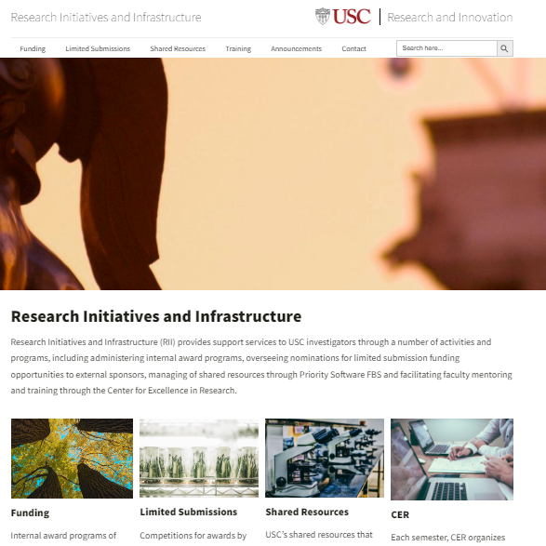
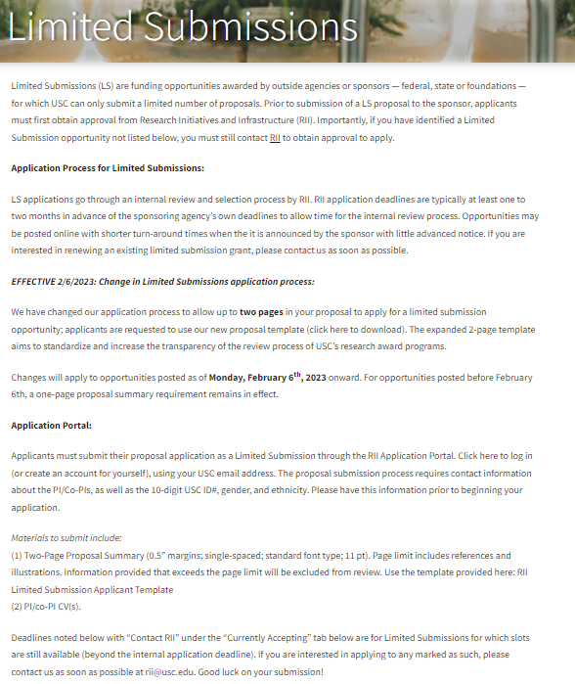
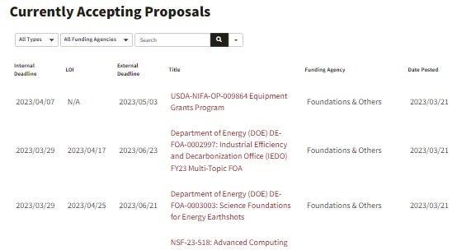
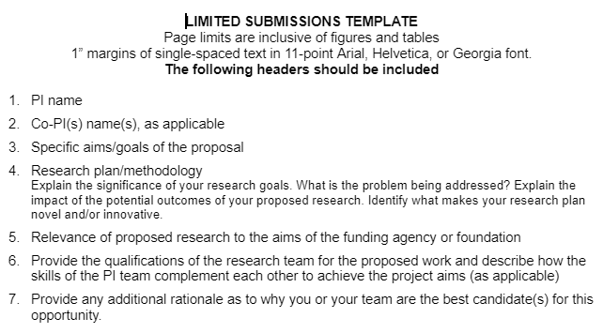
Limited Submissions
www.rii.usc.edu
Notes:
LOGO WILL CHANGE

Slide 41

Research and Innovation (R&I)
Award Programs
Questions??
Don’t hesitate to contact us
rii@usc.edu
Notes:
LOGO WILL CHANGE

